Slide 1
CRITICAL METAL MINERALIZATION IN MONGOLIA
S.Jargalan
Mongolian University of Science and Technology
Center for Research and Innovation of Technology minerals
World Mining Congress, Ulaanbaatar, Mongolia, 2022.07.12

Slide 2
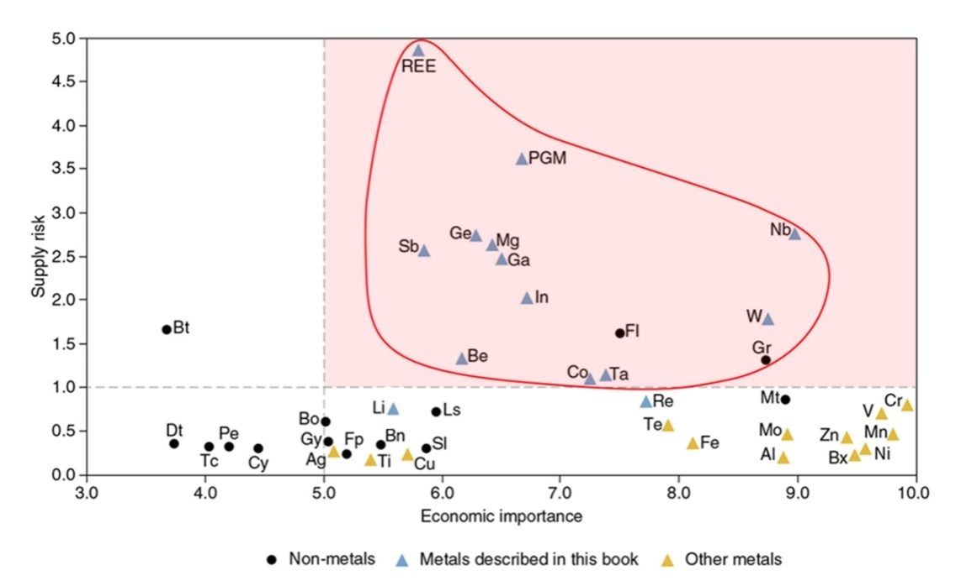
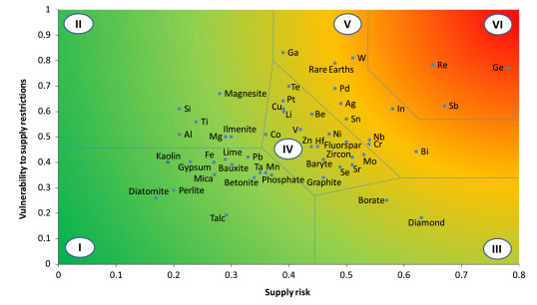
Critical metals tendency
Critical Minerals, EU
2011 | 2014 | 2017
As | As | As
Be | Be | Ba
Co | B | Be
CaF2 | Cr | Bi
Ga | Co | B
Ge | Coking coal | Co
Gr* | CaF2 | Coking coal
In | Ga | CaF2
Mg | Ge | Ga
Nb | In | Ge
PGE | Mg | Hf
REE | Magnesite | He
Ta | Gr | In
W | Nb | Mg
 | P | Gr*
 | PGE | Natural rubber
 | HREE | Nb
 | LREE | Phosphate rock
 | Si | P
 | Ta | Sc
 | W | Si
 |  | Ta
 |  | W
 |  | V
 |  | PGE
 |  | HREE
 |  | LREE
On the review of the list of critical raw materials for the EU and the implementation of the Raw Materials Initiative, EC, European Union, 2011., 2012., 2017
World Mining Congress, Ulaanbaatar, Mongolia, 2022.07.12
Notes:
Үйлдвэрлэл 4,0 хувьсгалын салшгүй хэсэг болох технологийн асар хурдацтай дэвшил, нэн шинэ технологиудтай уялдаад түүнийг бүтээхэд шаардагдах эрдэс баялгийн түүхий эдийн нийлүүлэлтийн асуудал хурцаар тавигдах болсон бөгөөд эрсдэлт хүчин зүйлүүдийг тооцоолсноор КРИТИКАЛ МЕТАЛЛ (түүхий эд) гэдэг ойлголтыг Европын холбооны гүйцэтгэх байгууллага болох Европын комисс (European Commission) анх бий болгож 2011 онд анхны 14 металлын жагсаалтыг гаргаж, 2014, 2017 онуудад шинэчилснээр уг жагсаалтад 22 элемент орж байна.
Европын холбооны эдийн засгийн комиссоос гаргасан графикт үзүүлснээр эдийн засгийн ач холбогдол нь >5.0 их, нийлүүлэлтийн эрсдэл >1.0 их металлуудыг “Критикал металл” гэсэн ангилалд оруулсан байдаг.

Slide 3
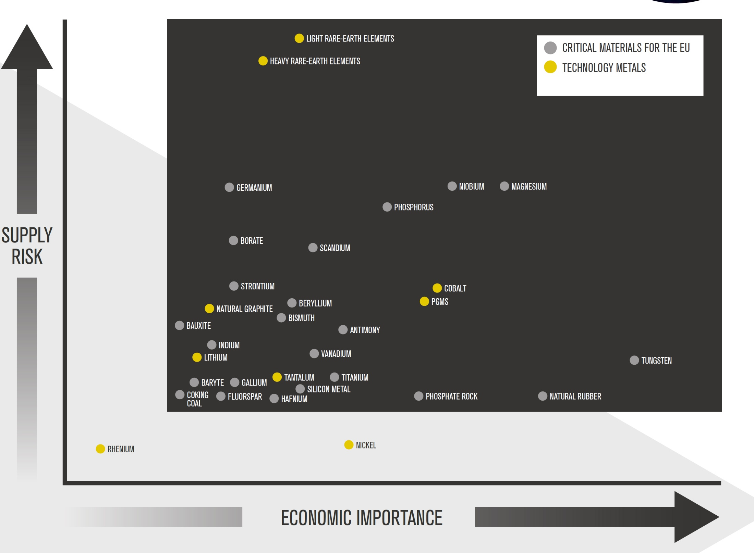
LREE
HREE
Ge
B
Sc
Nb
Mg
Sr
Co
Be
PGM
Bi
Sb
In
Li
V
Ga
Ta
Ti
Hf
Si
W
EU, 2020
World Mining Congress, Ulaanbaatar, Mongolia, 2022.07.12

Slide 4
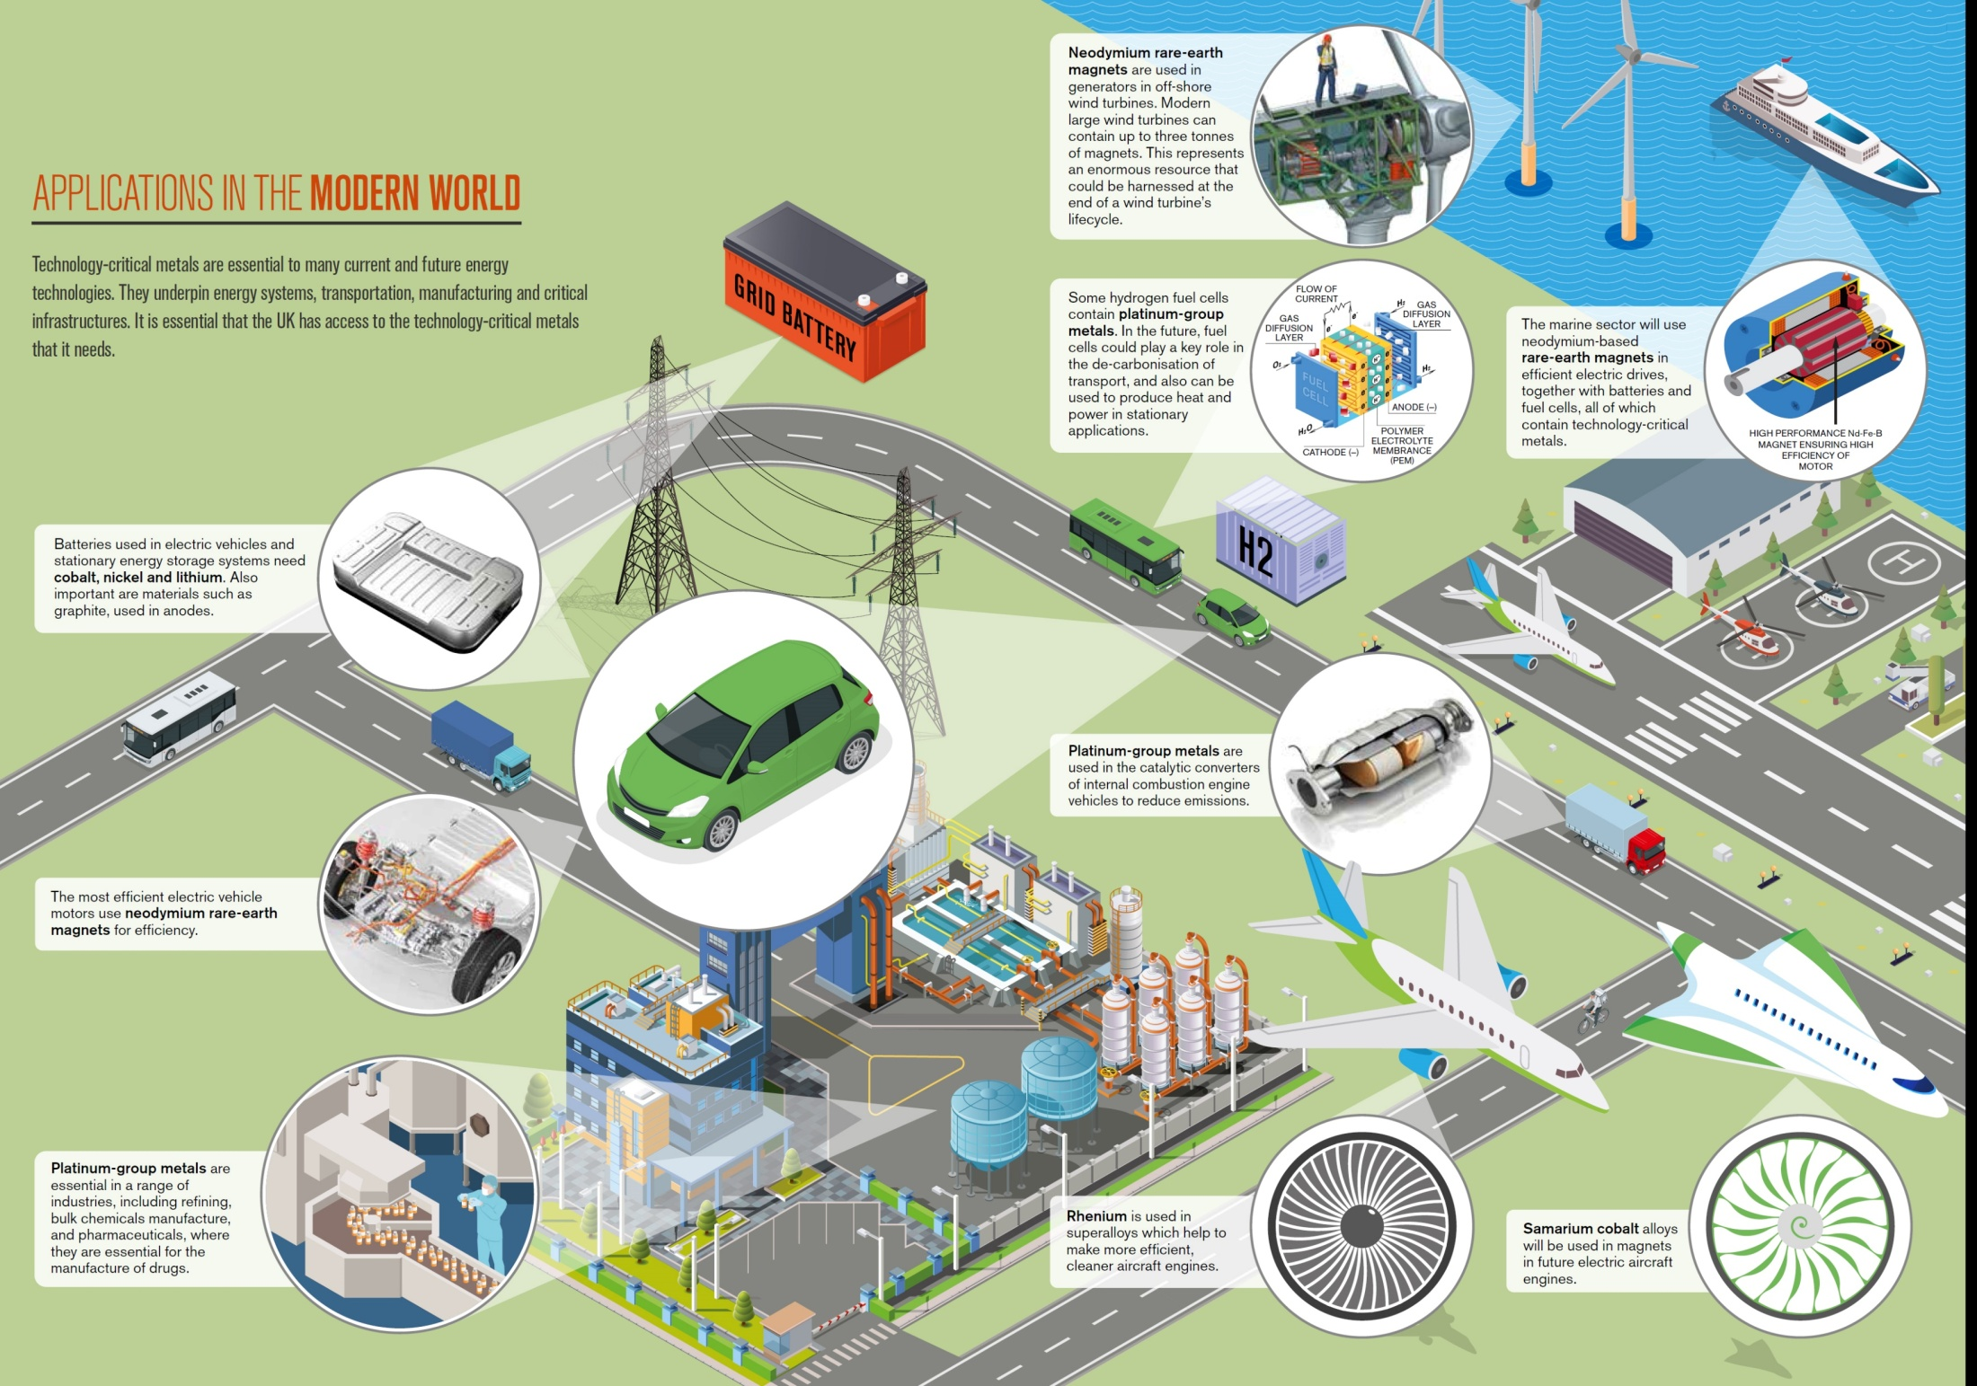
Critical metals usage
REE
PGM
REE
Co, Ni, Li
PGM
REE
PGM
Re
Sm, Co
World Mining Congress, Ulaanbaatar, Mongolia, 2022.07.12

Slide 5
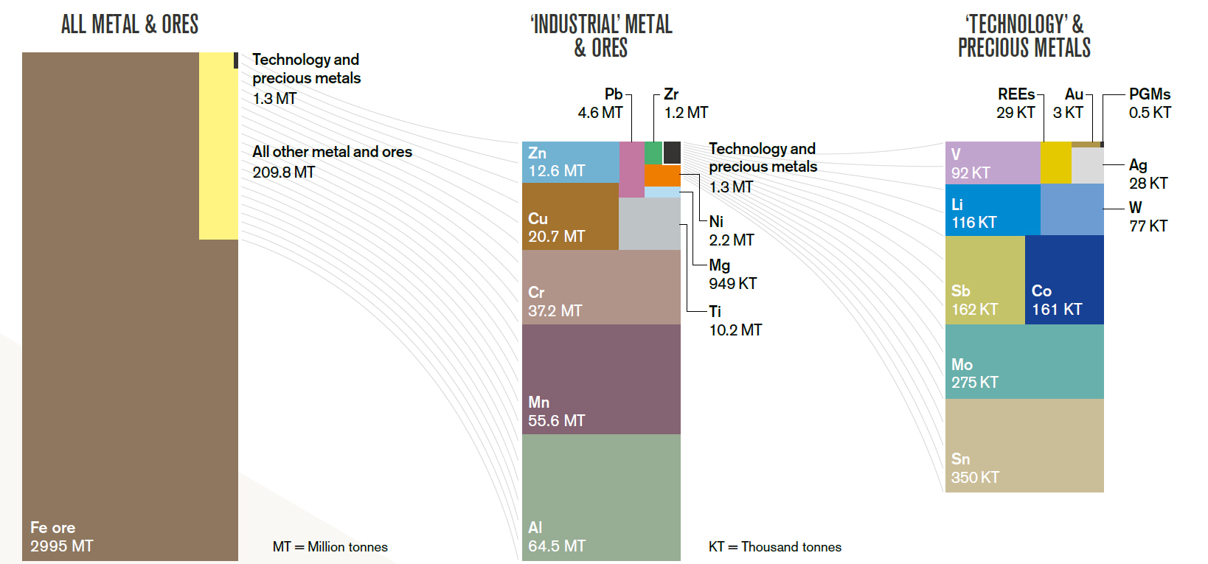
World Mining Congress, Ulaanbaatar, Mongolia, 2022.07.12

Slide 6
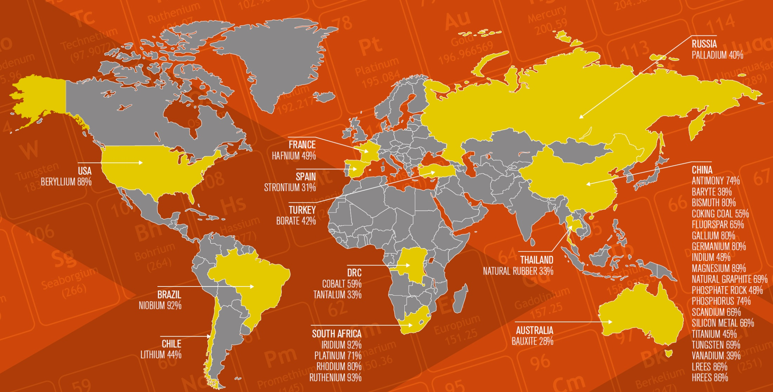
World production of critical metals
World Mining Congress, Ulaanbaatar, Mongolia, 2022.07.12

Slide 7
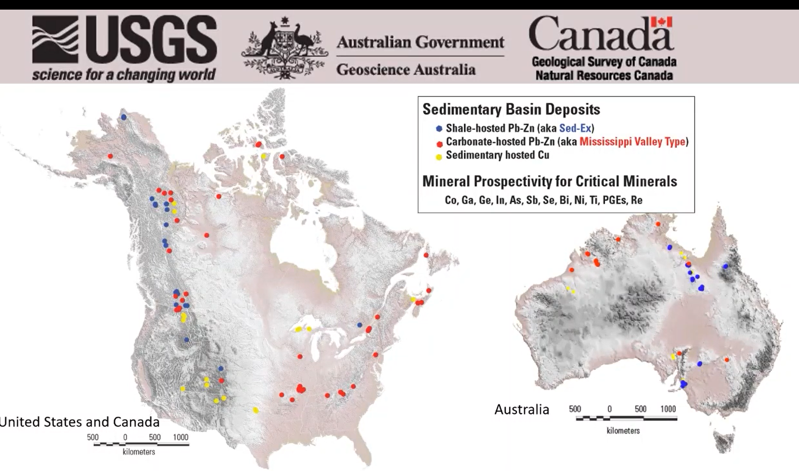
World Mining Congress, Ulaanbaatar, Mongolia, 2022.07.12

Slide 8
Rare earth elements
Lithium
Cobalt
Nickel+PGMs
Manganese
Magnesium
Graphite
World Mining Congress, Ulaanbaatar, Mongolia, 2022.07.12

Slide 9
RARE EARTH ELEMENTs IN MONGOLIA
Ulaan del
Khalzan burgedei
Tsagaan chuluut
Mushgai khudag
Khotgor
REE deposits
REE occurrences
Anomalous area
Lugiin gol
Khalzan burgedei Alkaline metasomatite
Mushgai khudag Carbonatite
Ulaan del Alkaline metasomatite
Khotgor Carbonatite
Lugiin gol Carbonatite
Tsagaan chuluut Placer
6 deposits
80 occurrences
300 anomalous areas
World Mining Congress, Ulaanbaatar, Mongolia, 2022.07.12

Slide 10
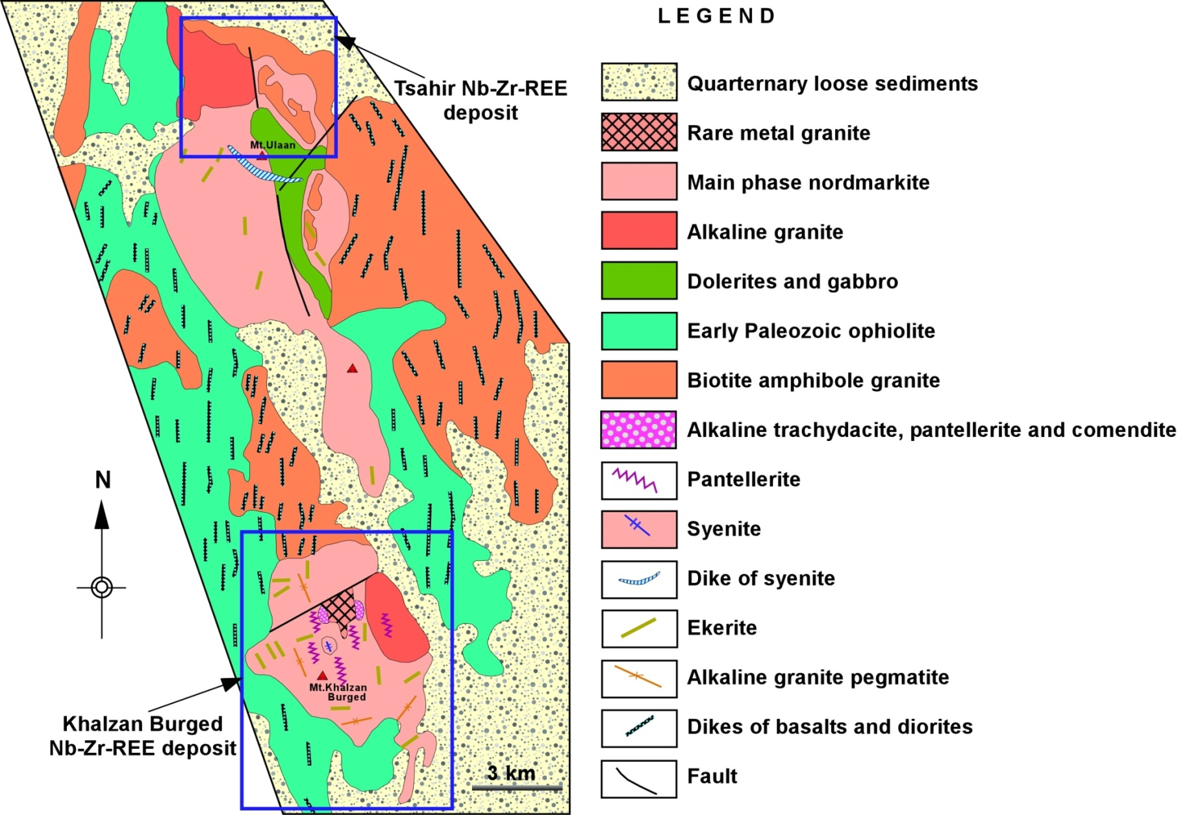
Khalzan Burgedei REE-Zr-Ta-Nb deposit
Khalzan Burgedei
World Mining Congress, Ulaanbaatar, Mongolia, 2022.07.12

Slide 11
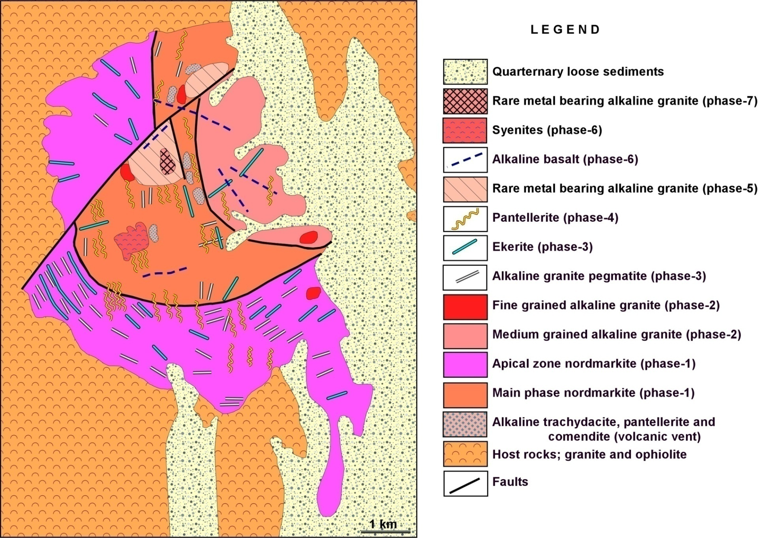
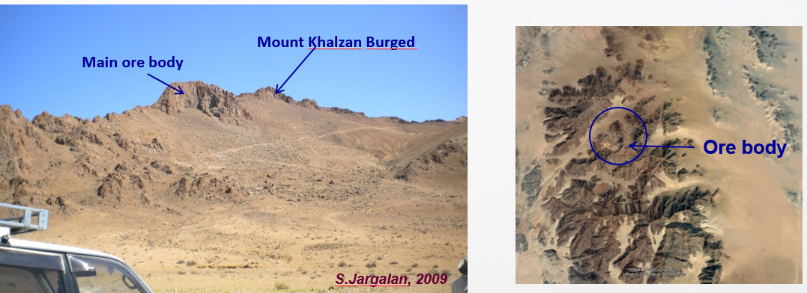
Geology of Khalzan Burgedei REE-Zr-Ta-Nb deposit
World Mining Congress, Ulaanbaatar, Mongolia, 2022.07.12

Slide 12
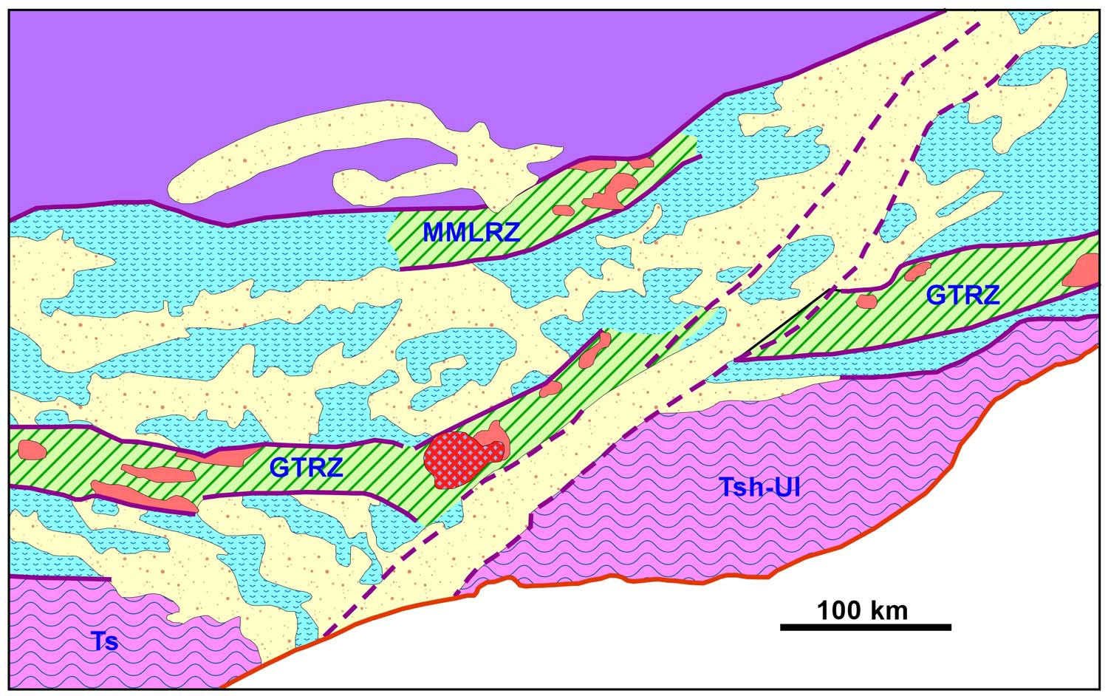
Mushgai khudag REE deposit
Mushgai khudag
Rift zones: GTRZ: Gobi-Tian Shan Rift Zone; MMLRZ: Main Mongolian Lieament Rift Zone;
Microcontinental blocks: Tsh-Ul: Toto Shan-Ulaan Uul; Ts: Tsagaan Uul; ZB: Zuun Bayan Fault system
World Mining Congress, Ulaanbaatar, Mongolia, 2022.07.12

Slide 13
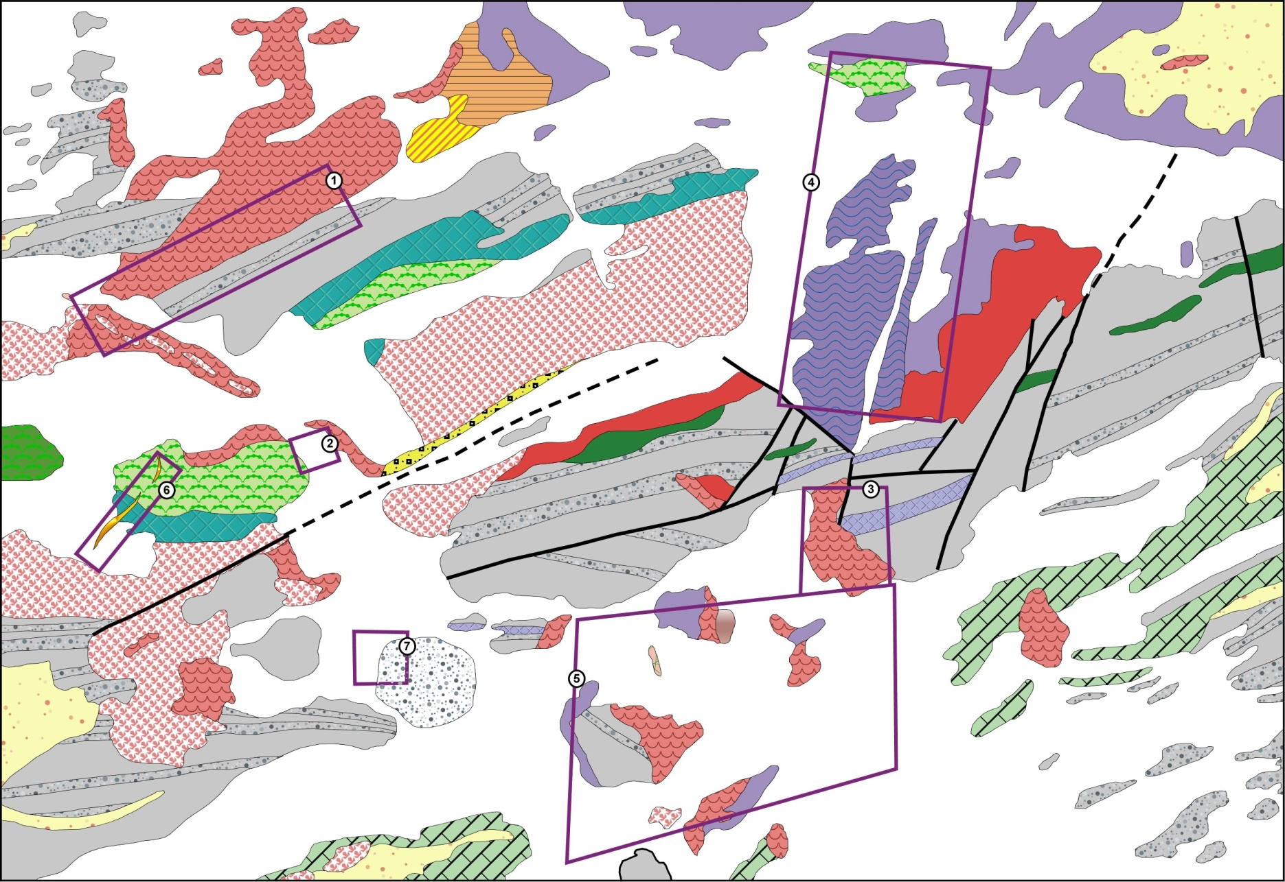
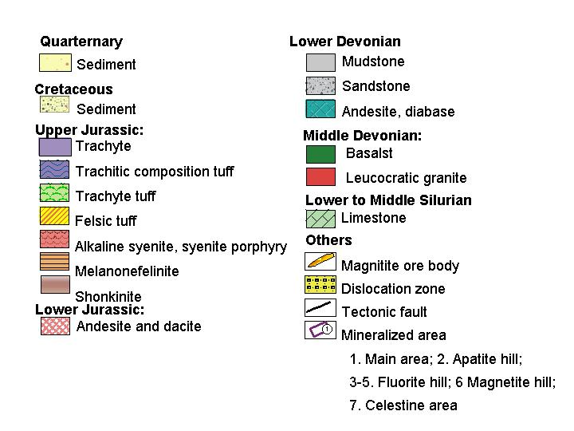
Geology of Mushgai khudag REE deposit
After Chuluunbaatar et all., 1991
World Mining Congress, Ulaanbaatar, Mongolia, 2022.07.12

Slide 14
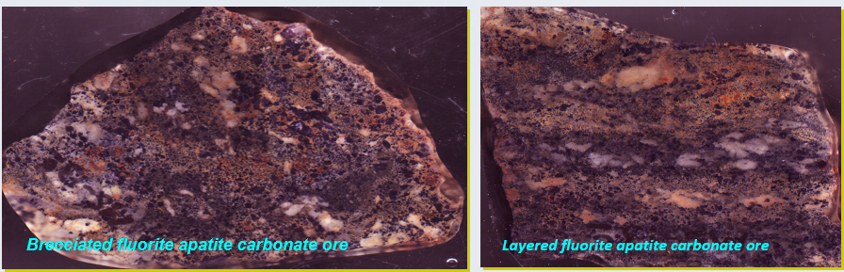
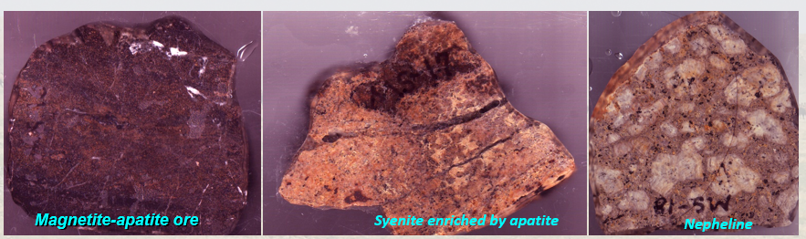
Main ore body
Occupies 102000 m² area (~700 x 150m) NE trending ore body
Mineralized breccia: Carbonatite veins and stockworks with magnetite and apatite ore in the central part
- Fragments of breccia: syenite; syenite porphyry; trachyte;
magnetite-apatite ore; carbonate ore
- Cements of breccia: Fluorite; carbonate; quartz; chalcedony;
barite, celetite, partly apatite
➢ Average grade: ΣREE = 1.63%
TR₂O₃ = 1.29%
SrO = 1.49%
BaO = 1.27%
➢ Ore minerals: bastnaesite, fluorite; apatite and celetite
S.Jargalan, 2006
World Mining Congress, Ulaanbaatar, Mongolia, 2022.07.12

Slide 15
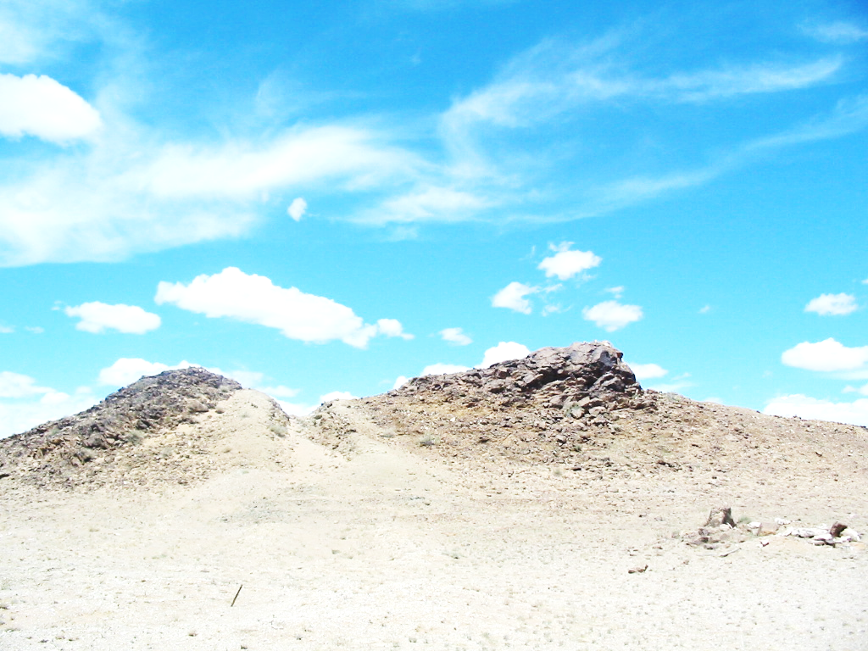
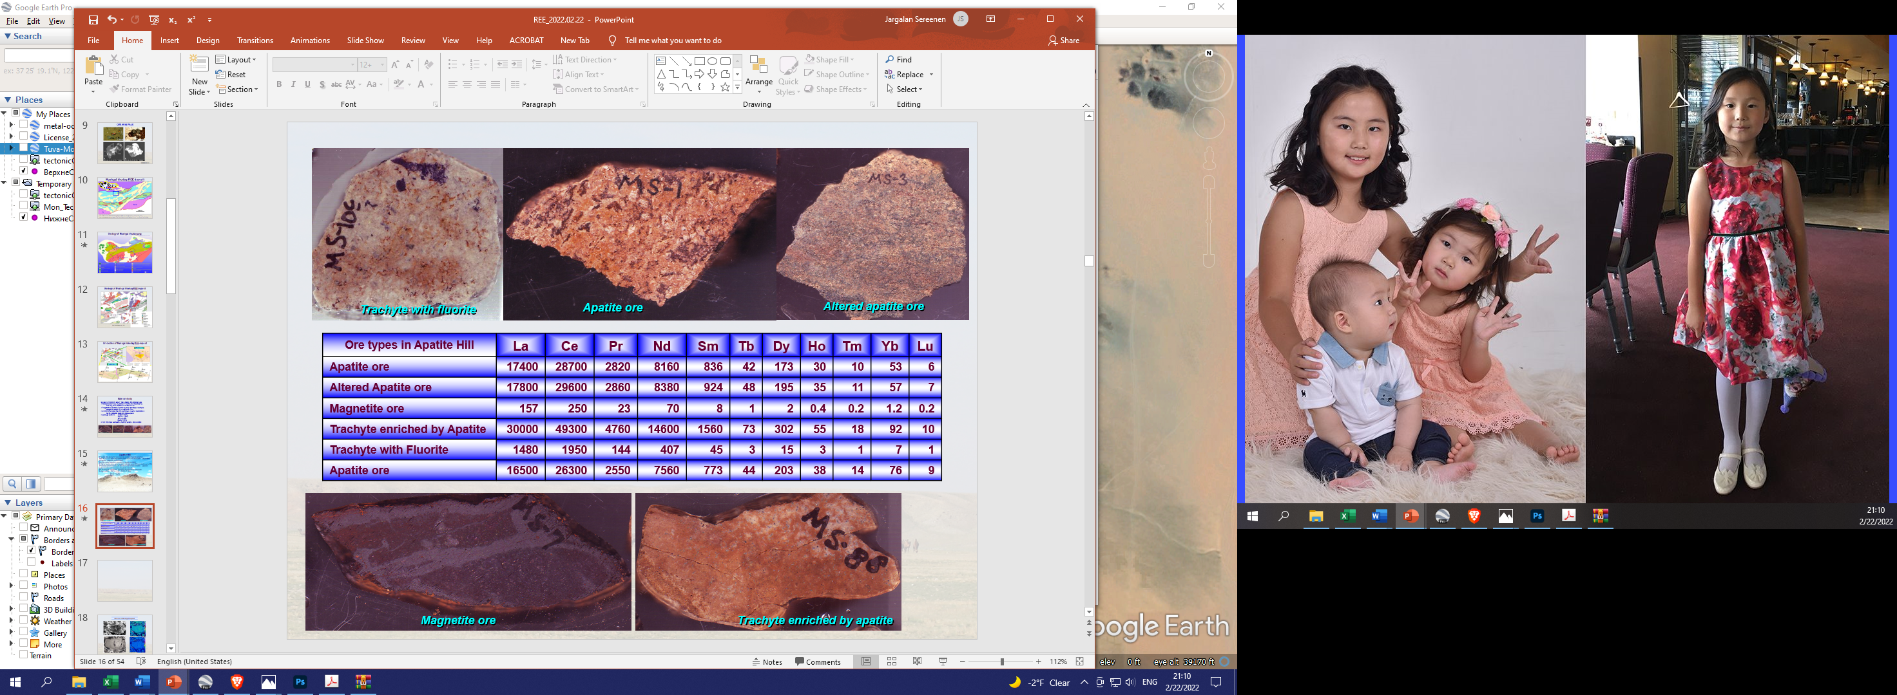
Apatite hill
Vein shaped ore body
50-60% consists of apatite (up to75-80%)..
Contact of syenite body enriches in REE
Celestite 20%, barite 10% and fluorite
Low temperature alteration and weathering; hematite, gypsum, pyrite, limonite, phosphate minerals.
Ore minerals: bastnaesite, monazite, synchisite
High in REE: TR₂O₃ = 4.39 – 13.9% (7.18%)
Sm₂O₃ = 0.29%
Gd₂O₃ = 0.14%
S.Jargalan, 2006
World Mining Congress, Ulaanbaatar, Mongolia, 2022.07.12

Slide 16
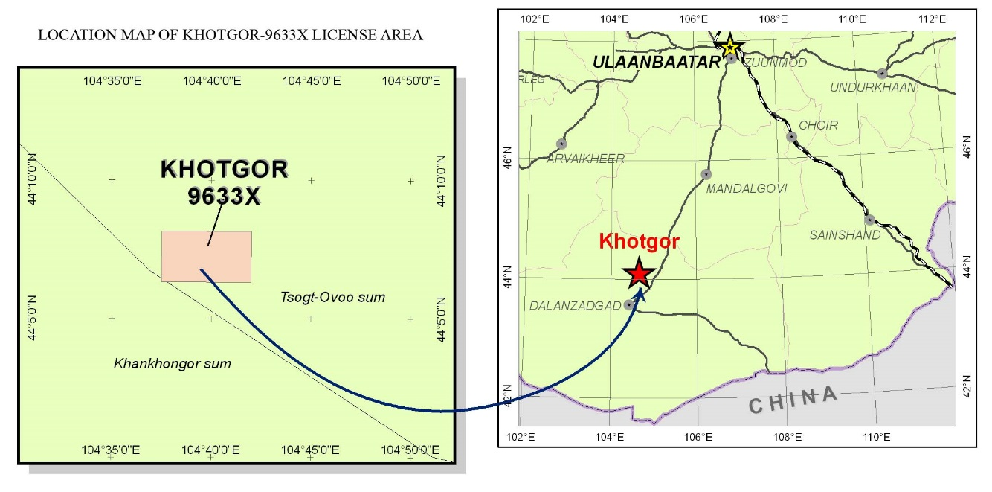
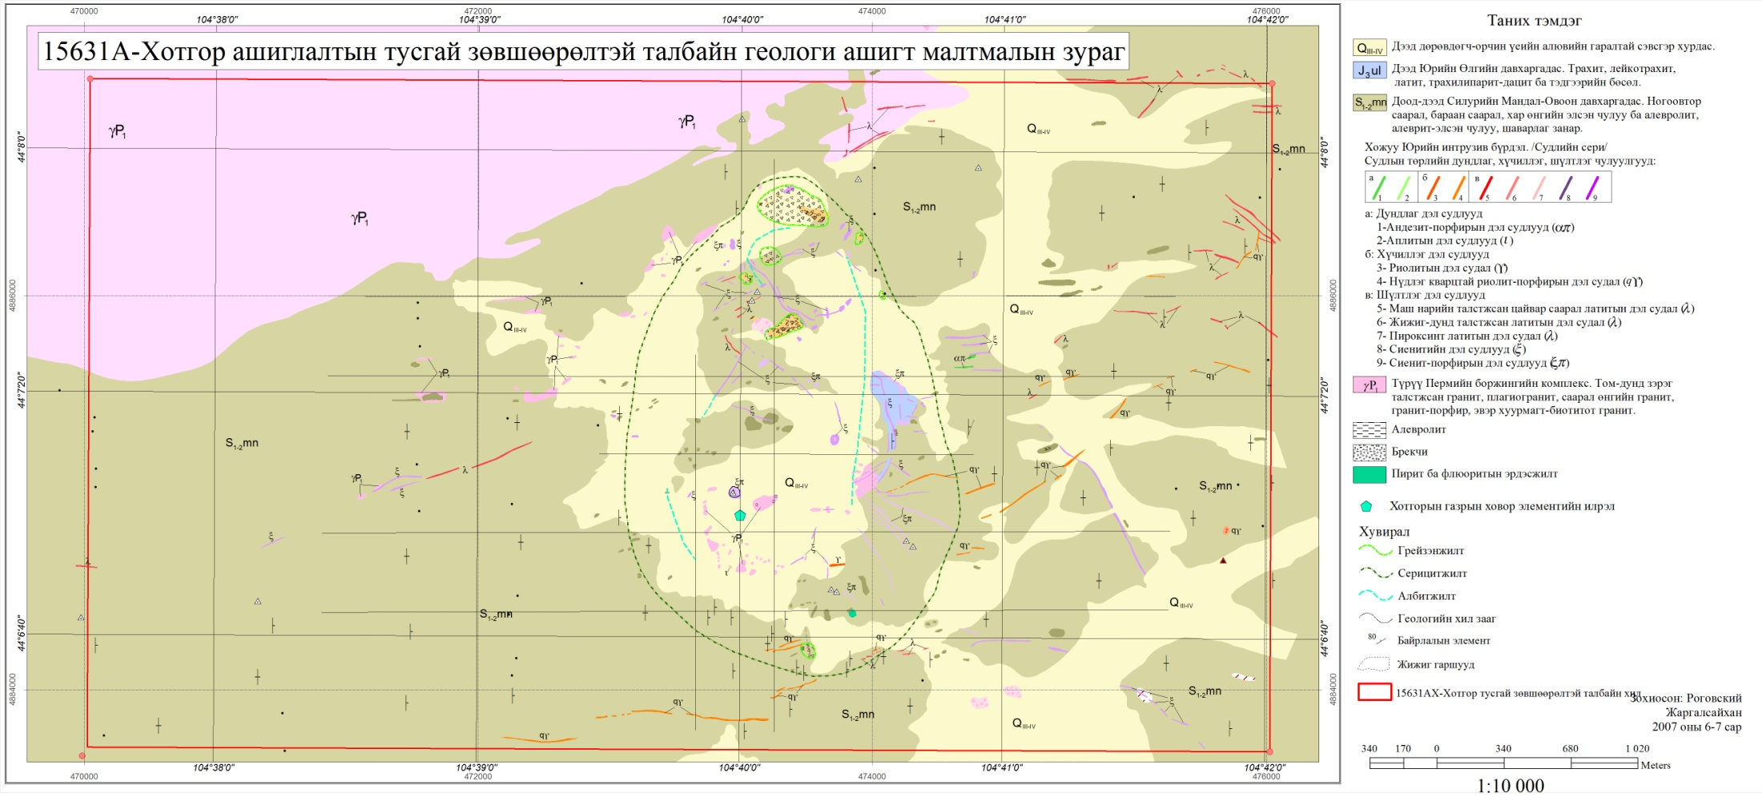
KHOTGOR REE DEPOSIT
Ж.Даваа, 2017
World Mining Congress, Ulaanbaatar, Mongolia, 2022.07.12

Slide 17
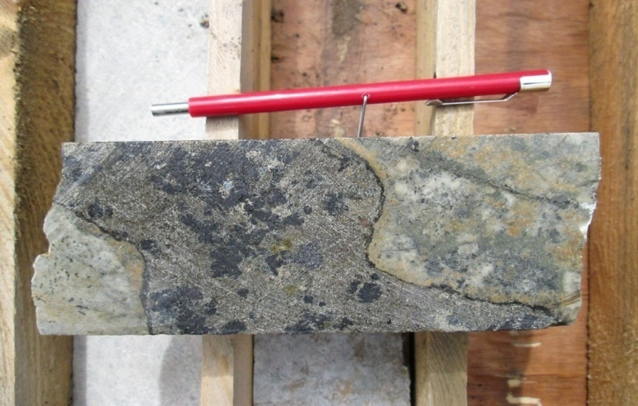
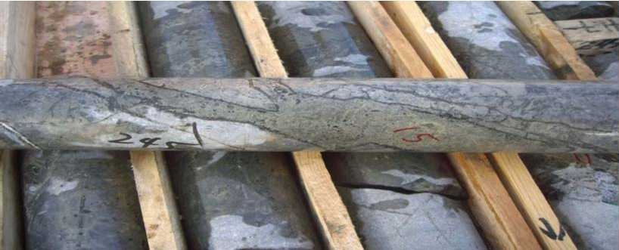
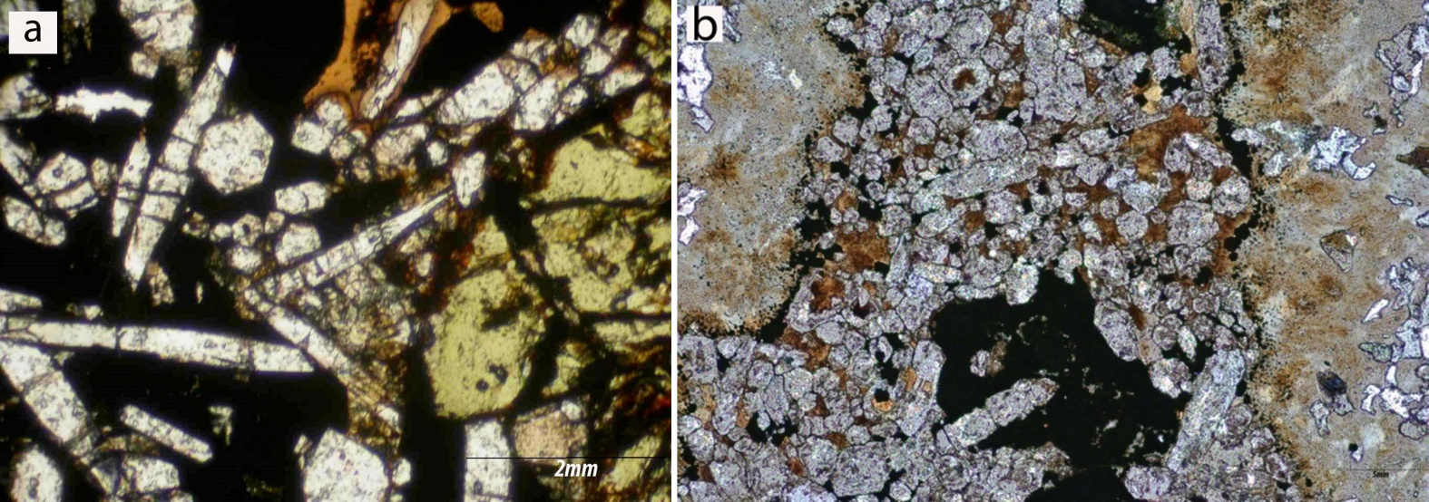
REE mineralization
World Mining Congress, Ulaanbaatar, Mongolia, 2022.07.12
J.Dawaa, 2018

Slide 18
Lugiin gol REE deposit
Mushgai khudag
Меланомонцонит ба идиолит
Псевдо лейцит сиенит
Хувираагүй сиенит
Хувирсан сиенит
Хил заагийн сиенит
Хил заагийн эвэржилт
Агуулагч чулуу
Дэл судлууд, карбонатит
World Mining Congress, Ulaanbaatar, Mongolia, 2022.07.12

Slide 19
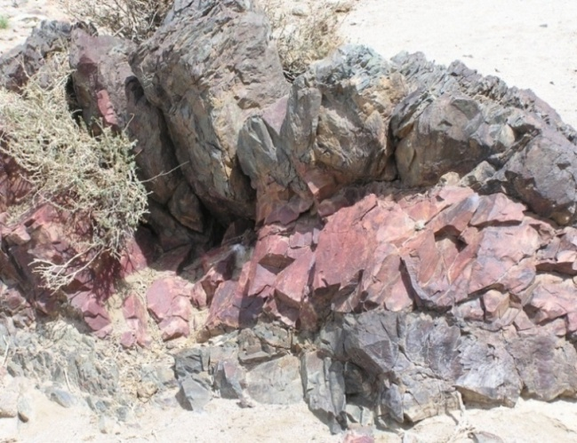
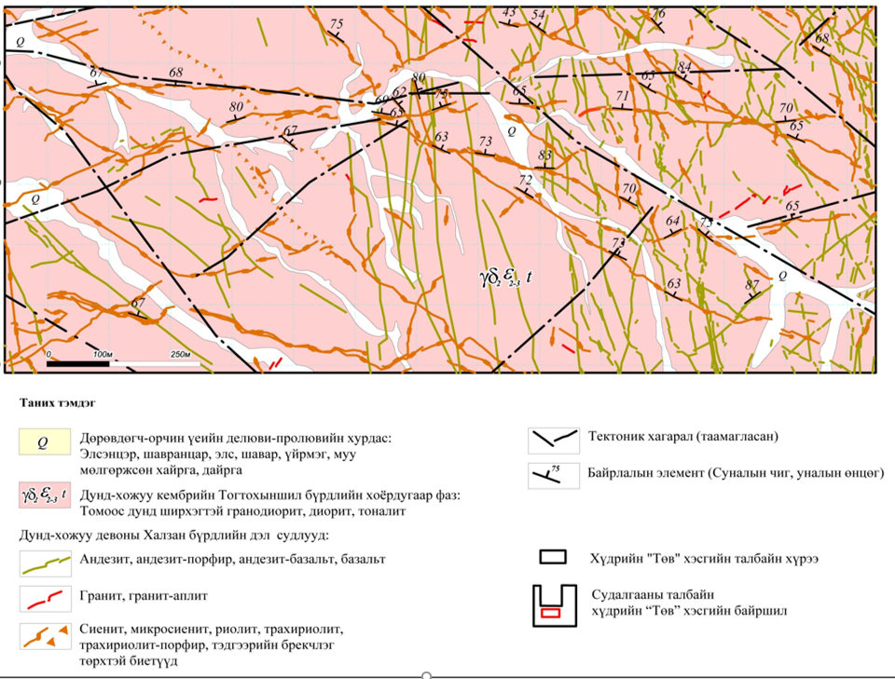
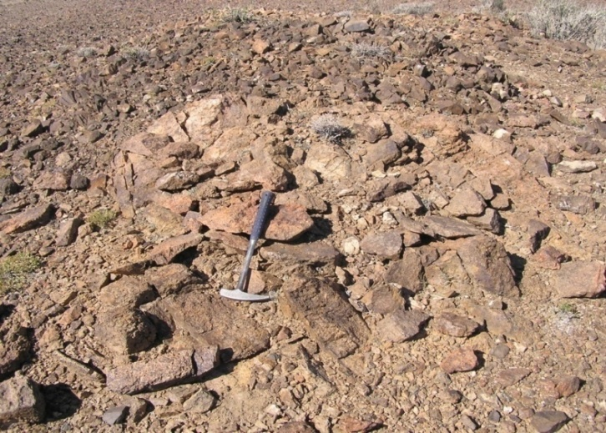
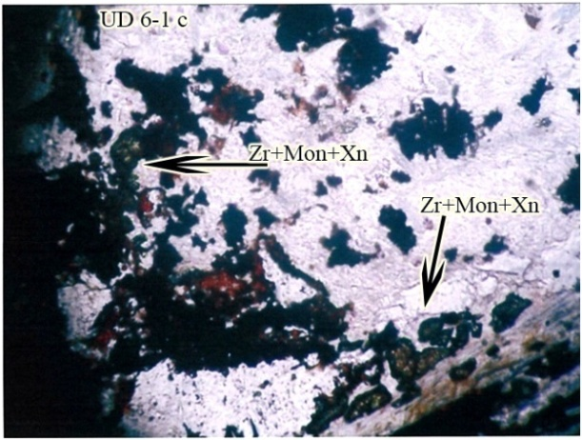
Ulaan del REE-Nb-Zr deposit
S.Oyunbat, 2021
World Mining Congress, Ulaanbaatar, Mongolia, 2022.07.12

Slide 20
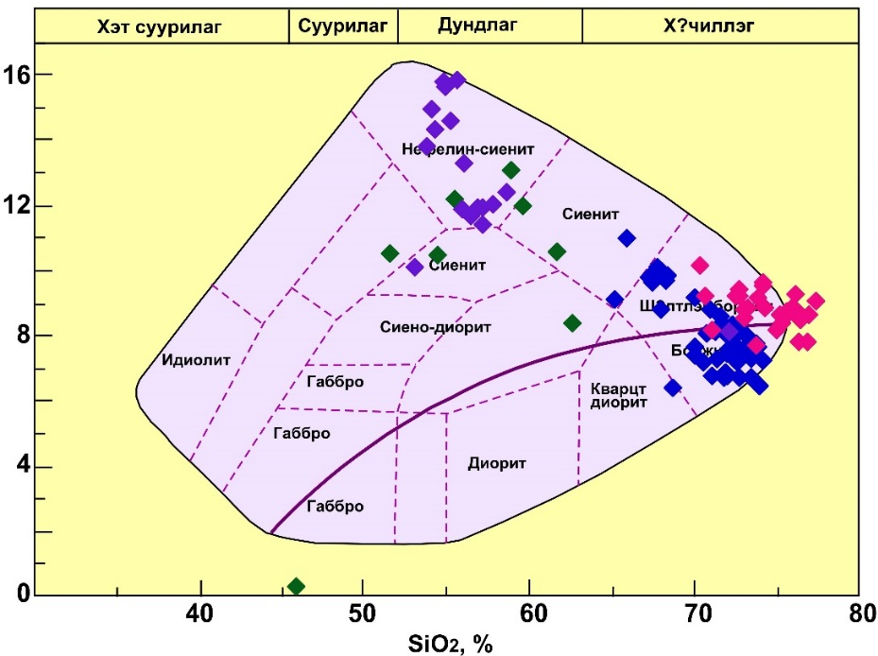
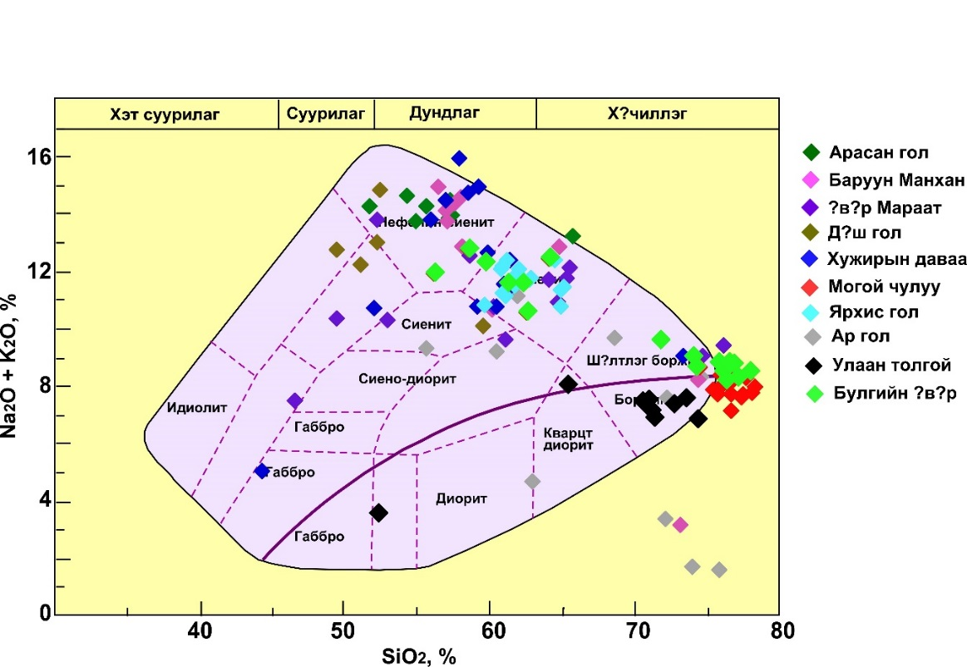

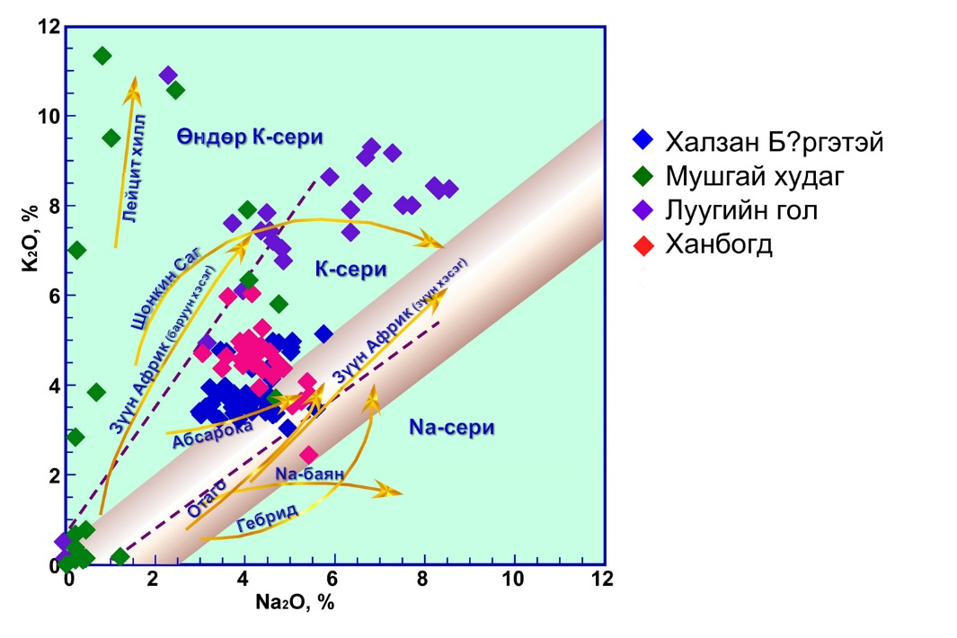
PETROCHEMISTRY OF REE AND RELATED ROCK
Khalzan Burgetei /Alk/
Mushgai khudag /Car/
Luugiin gol /Car/
Khan Bogd /Alk/
ALKALINE METASOMATITE REE
ALKALINE GRANITE
Khalzan Burgetei /Alk/
Mushgai khudag /Car/
Luugiin gol /Car/
Khan Bogd /Alk/
CARBONATITE RELATED REE
SYENITE AND NEPHELINE
CARBONATITE RELATED REE
POTASSIUM RICH
World Mining Congress, Ulaanbaatar, Mongolia, 2022.07.12

Slide 21
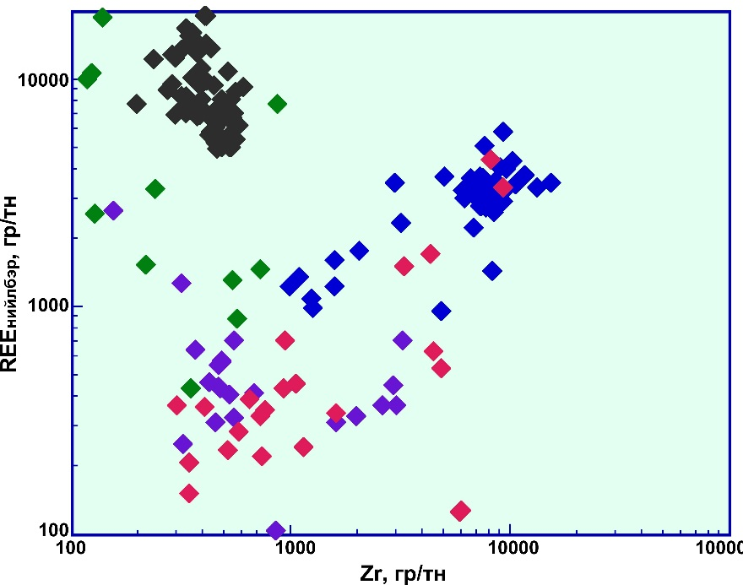
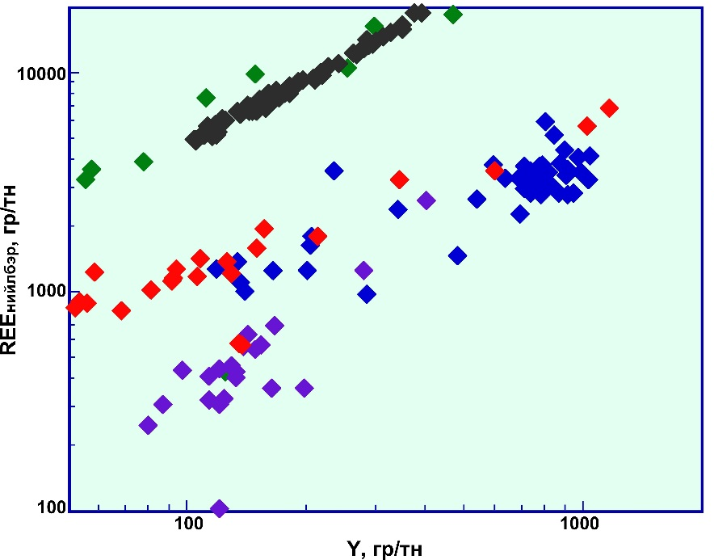
Relative to increasing Zirconum content alkaline related REE show good positive correlation, but carbonatite related REE has negative trend
Khalzan Burgetei /Alk/
Mushgai khudag /Car/
Luugiin gol /Car/
Khan Bogd /Alk/
Relative to increasing Yttrium content all types of REE mineralization show good positive correlation
Khalzan Burgetei /Alk/
Mushgai khudag /Car/
Luugiin gol /Car/
Khan Bogd /Alk/
World Mining Congress, Ulaanbaatar, Mongolia, 2022.07.12

Slide 22
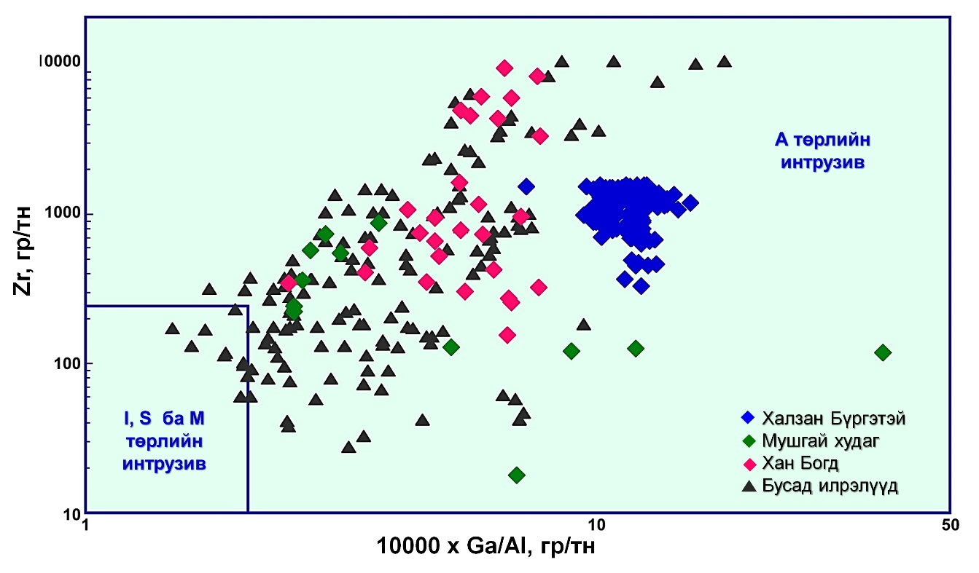
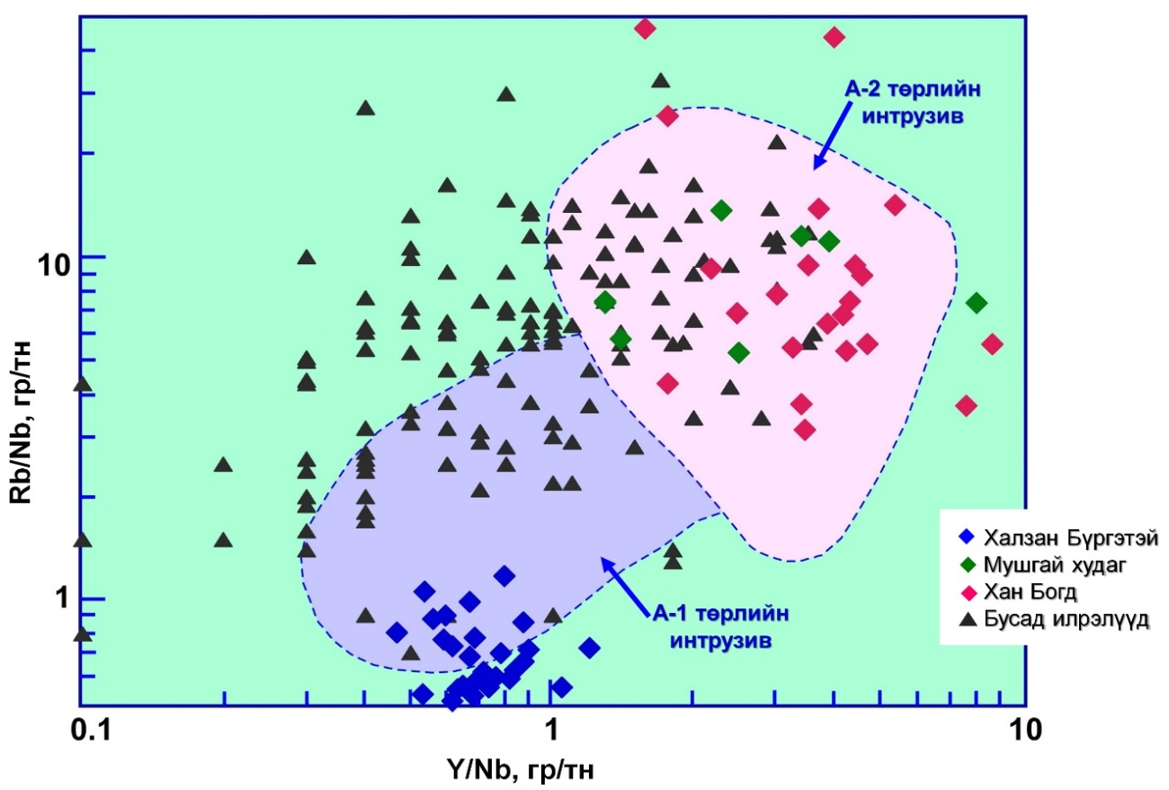
All types of rocks, which has spatial and genetic relation, are all A-type /An-Orogenic/ magma source
Khalzan Burgetei /Alk/
Mushgai khudag /Car/
Luugiin gol /Car/
Khan Bogd /Alk/
(Walen, 1987)
There is not clear difference between A1 /oceanic island basalt/ and A2 /post collisional or post orogenic/ types. Khalzan Burgetei is A1 but Khan Bogd is A2.
Khalzan Burgetei /Alk/
Mushgai khudag /Car/
Luugiin gol /Car/
Khan Bogd /Alk/
World Mining Congress, Ulaanbaatar, Mongolia, 2022.07.12
(Eby, 1992)

Slide 23
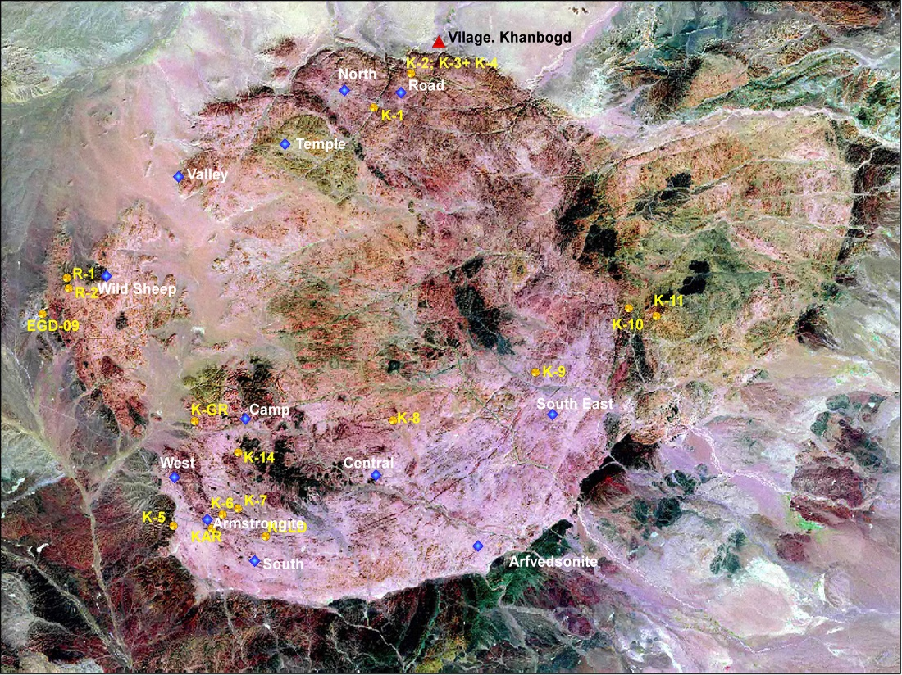
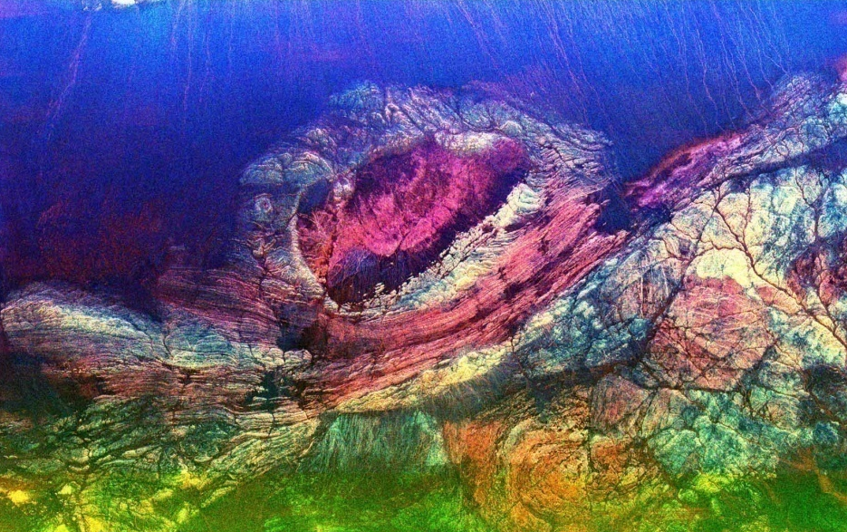
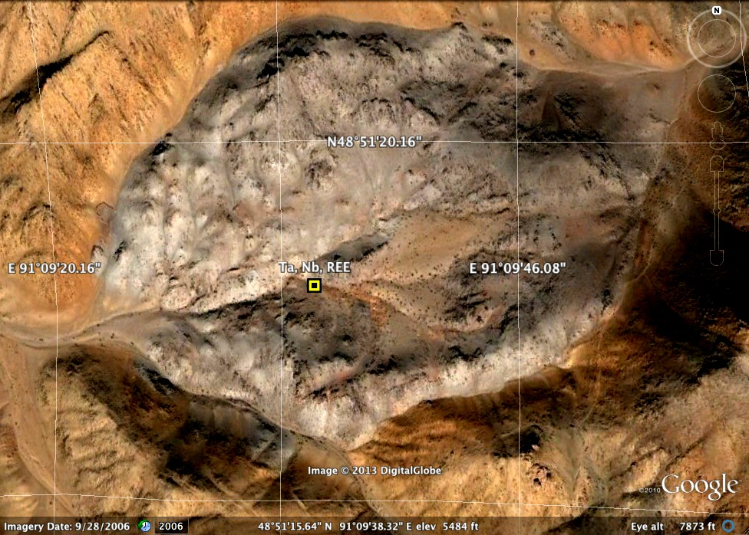
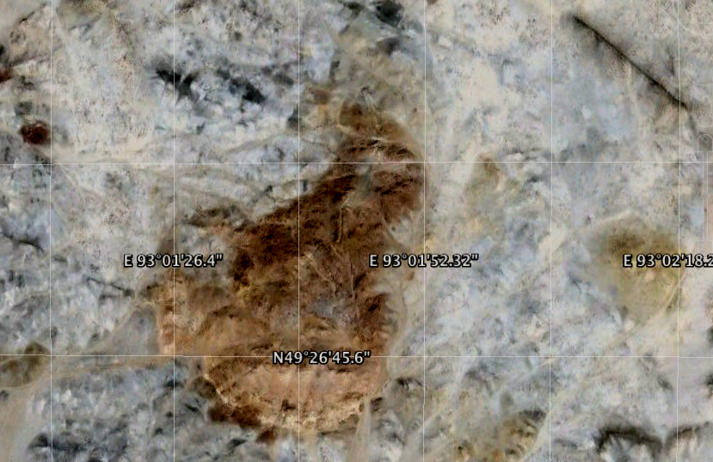
ГХЭ-ийн ХҮДЭРЖИЛТ СТРУКТУР
Хан Богд
Баянхонгор, Шинэжинст, Бөглөө толгой
Баян-Өлгий, Майхант
Увс Наранбулаг, Улаан толгой
World Mining Congress, Ulaanbaatar, Mongolia, 2022.07.12

Slide 24
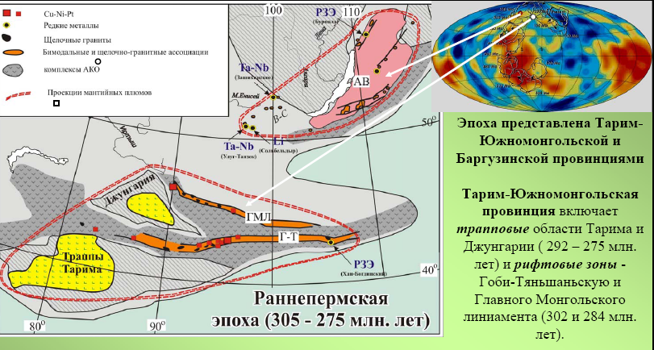
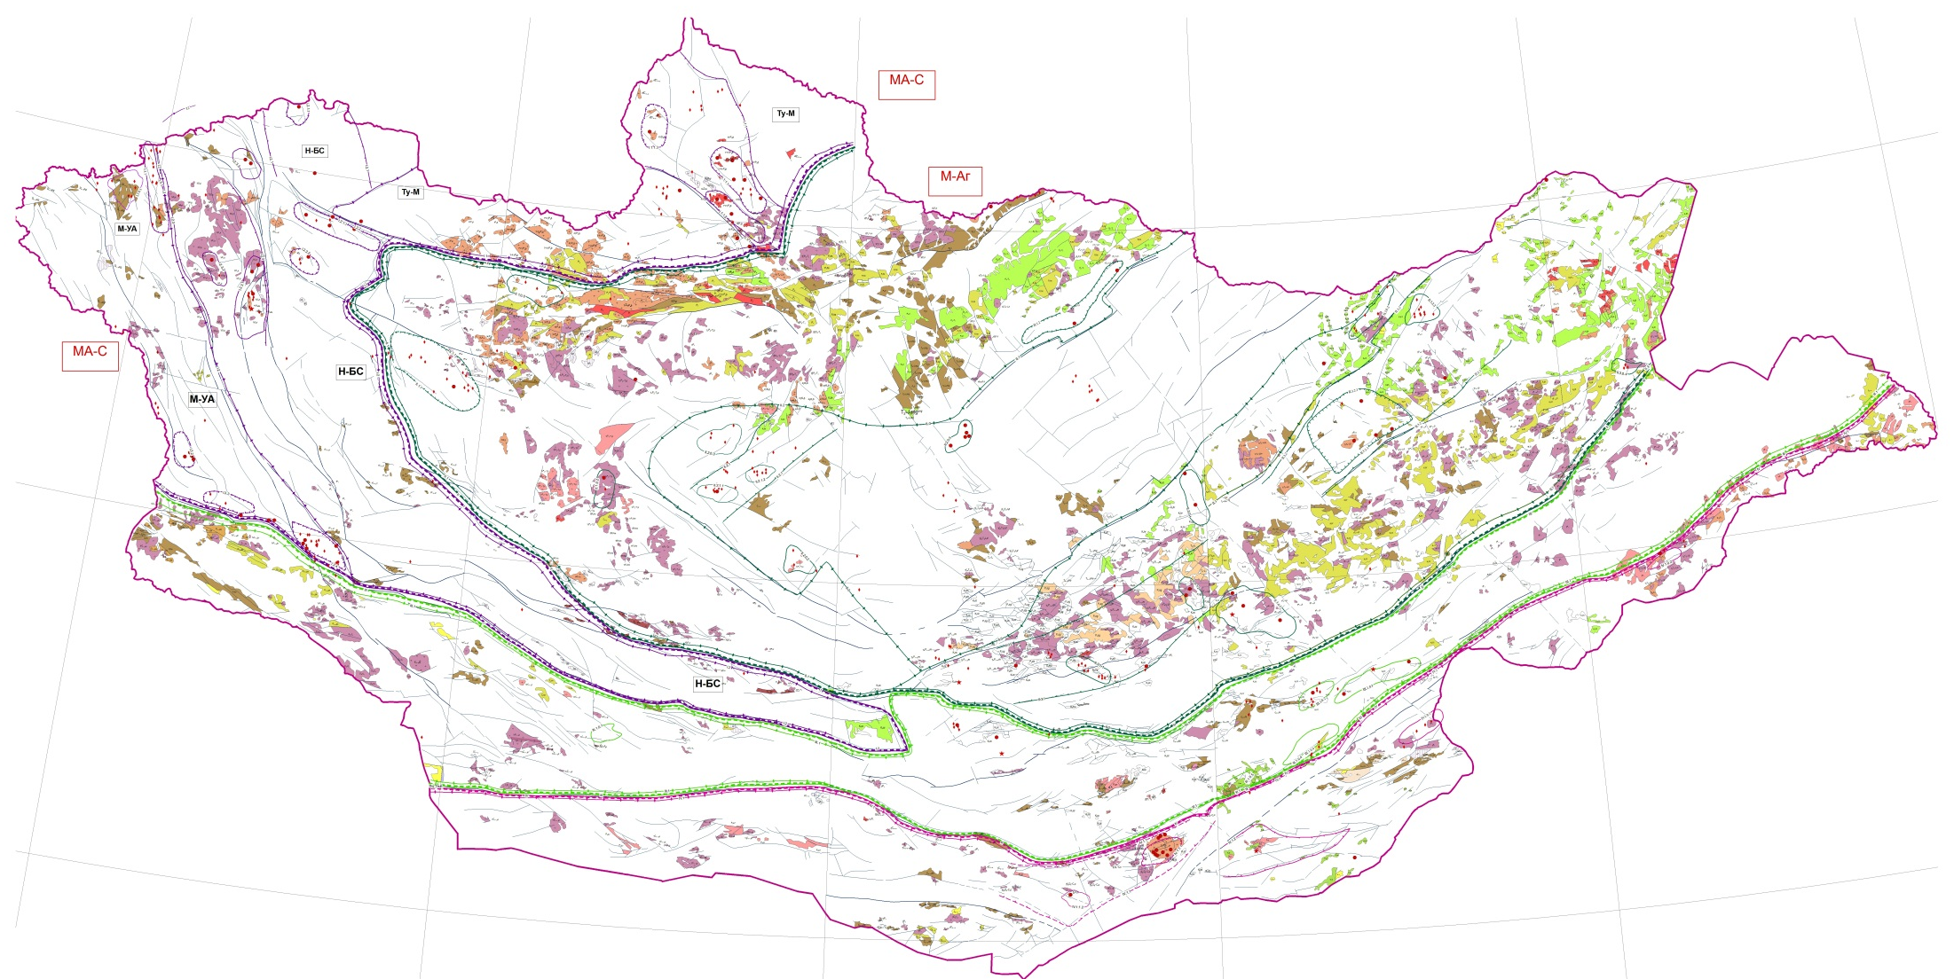
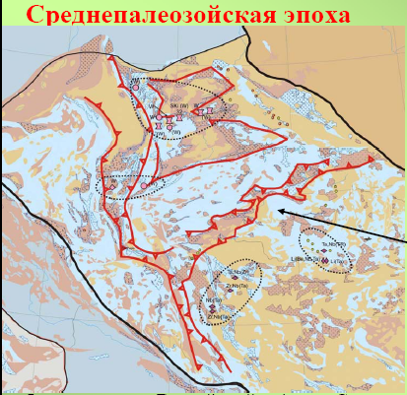
МОНГОЛ ОРНЫ ГХЭ-ийн МЕТАЛЛОГЕНИ
Devonian maybe Carboniferous REE mineralization related with nepheline and syenite mainly rich in Nb, Y and HREE
Devonian REE mineralization related with alkaline magmatism mainly rich in Zr, Nb and HREE
Yarmoluk and Kuzmin, 2014
Jurassic to Cretaceous REE mineralization related with carbonatite. LREE rich
Permian-Triassic REE mineralization both alkaline and carbonatite related
Yarmoluk and Kuzmin, 2014
World Mining Congress, Ulaanbaatar, Mongolia, 2022.07.12

Slide 25
REE resources Mongolia
№ | Ордын нэр | Type of metall | Grade, % | Ore reserve, tn |  | Reserve of metall, tn |  | Reference
 |  |  |  | В (Indicated) | С (Inferred) | В | С
1 | Mushgai khudag | TR₂O₃ | 1.02 | 14,413.60 | 3,224.38 | 194,456.3 | 37,352.40 | 2010
 | Mushgai khudag /monazite/ | TR₂O₃ | 5.04 | 1,070.75 | 107.30 | 53,966.0 | 1,755.74 | 2012
 | Mushgai khudag /fluorite/ | TR₂O₃ | 0.96 |  | 2,788.42 |  | 26,768.80 | 2012
 | Mushgai khudag /West zone/ | Се₂O₃ | 1.05 |  | 22.76 |  | 2,709.50 | 2013
 |  | La₂O₃ |  |  | 1,935.36 |  | 16.30
 |  | Nd₂O₃ |  |  | 193.54 |  | 1.58
2 | Khotgor | REE | 1.26 | 26,863.40 | 12,887.70 | 338,690.0 | 148,040.00 | 2010
3 | Lugiin gol | REE | 2.67 | 159.18 | 347.03 | 5,489.8 | 8,015.66 | 2009
 | Lugiin gol (West zone) | REE | 2.71 |  | 35,098.80 |  | 1,013.89 | 2013
4 | Khalzan Burgedei /19329/ | TR+Y | 0.23 | 45,384.10 | 40,759.02 | 104,395.4 | 103,762.50 | 2014
 |  | Zr | 0.29 |  |  | 132,307.1
 |  | H TR+Y | 0.056 | 42,803.08 | 35,396.86 | 23,854.9 | 29,633.40
 |  | Nb | 0.041 | 44,916.46 | 36,267.38 | 18,580.5 | 23,966.00
 | Khalzan Burgedei /006911/ | REE | 0,44 | 22,318,229.20 | 22,512,651.00 | 97,168.7 | 94,485.24 | 2015
 |  |  | 0,42
 | Khalzan Burgedei /012335/ | REE | 0,45 0,46 | 162,955,474.60 | 60,389175,33 | 731,805.6 | 279,683.00
5 | Ulaan del | REE | 0.164 |  | 82,130.40 |  | 124.79 | 2017
 |  | Zr | 0.335 |  |  |  | 238.90
 |  | Nb | 0.05 |  |  |  | 34.80
6 | Tsagaan chuluut (Placer) | Monazite |  |  |  | 52.25 | 222.30 | 2017
 |  | U | 0.46 |  |  | 0.23 | 1.15
 |  | TR₂O₃ | 7.4 |  |  | 3.86 | 18.60
 |  | Се₂O₃ | 27.2 |  |  | 14.20 | 60.42
 |  |  |  | 185,449,314.4 | 22,681,679.6 | 1,700,714.4 | 757,328.8
Total REE reserve: |  |  |  | Monazite |  | 52.25 | 222.3
 |  |  |  | REE+TR₂O₃+Ce₂O₃+La₂O₃+Nd₂O₃ |  | 1,549,830.6 | 733,381.4
 |  |  |  | REE (B+C) |  | 2,283,212.03
World Mining Congress, Ulaanbaatar, Mongolia, 2022.07.12

Slide 26
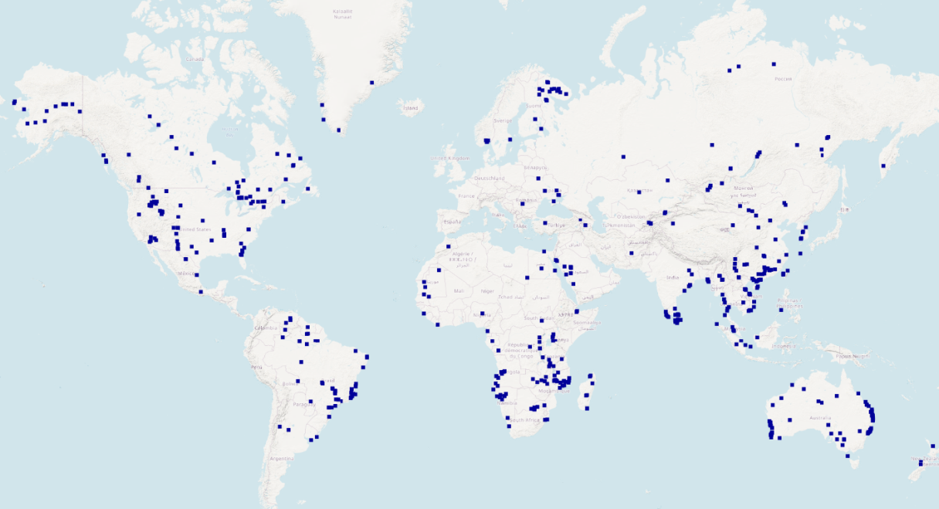
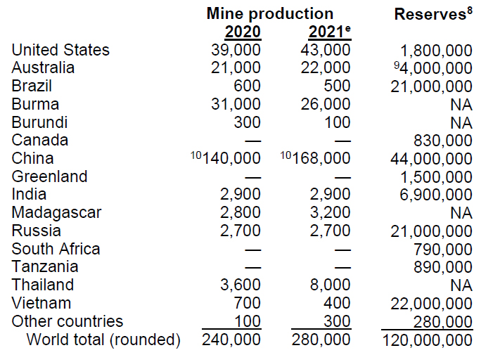
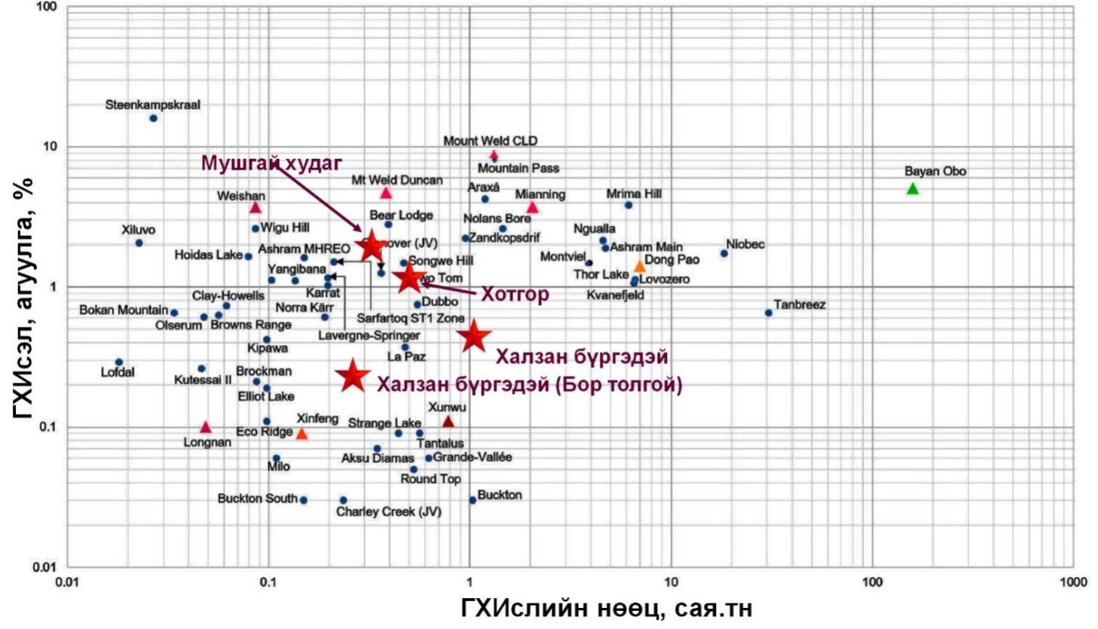
REE resources Mongolia
USGS, 2021
Registered Indicated (B) and Inferred (C) reserve of ReO of Mongolia estimates as 2,283,212.03
1.90% of World reserve
Лугийн гол
Mushgai khudag- Glenover
Khotgor-TwoTom
KhalzanBurgedei-La Paz
Lugiin Gol - Xiluvo
Baolu Zhou, 2017
World Mining Congress, Ulaanbaatar, Mongolia, 2022.07.12

Slide 27
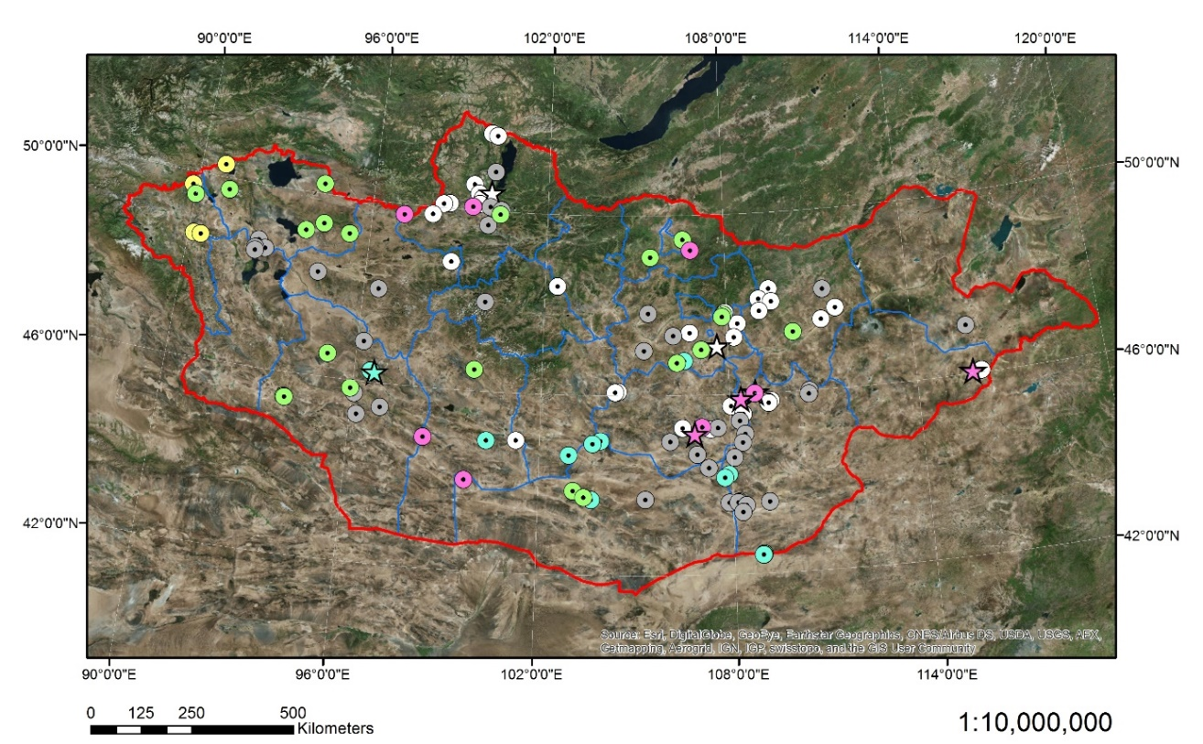
Li: 2 deposits, 7 occurrences
Ni: 3 deposits, 37 occurrences
Co: 6 occurrences
Mn: 6 deposits, 22 occurrences,
Mg: 1 deposit, 12 occurrences,
Gr: 4 deposit, 32 occurrences
LITHIUM, NICKEL, COBALT, MANGANESE, MAGNESIUM, GRAPHITE
World Mining Congress, Ulaanbaatar, Mongolia, 2022.07.12

Slide 28
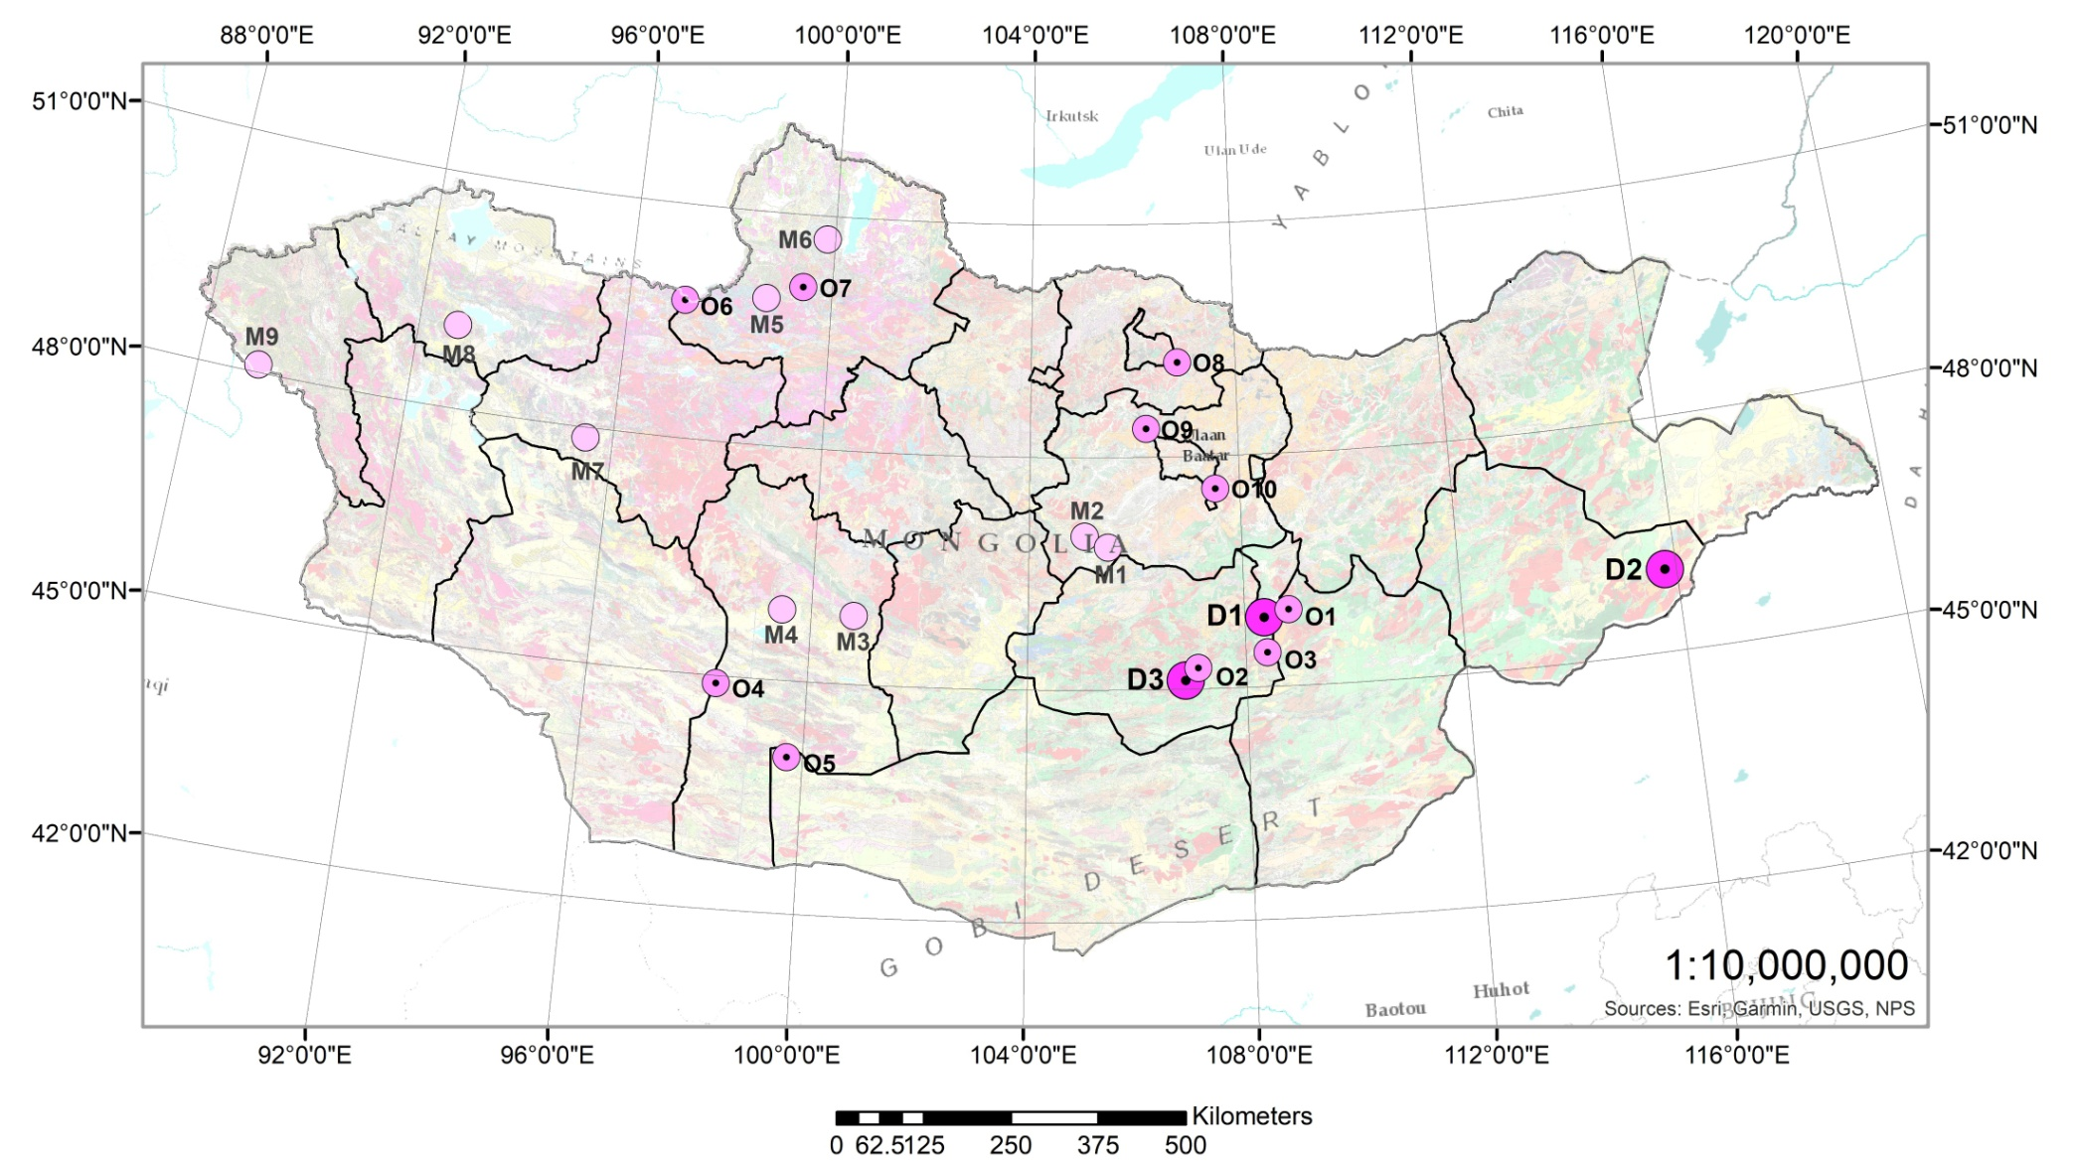
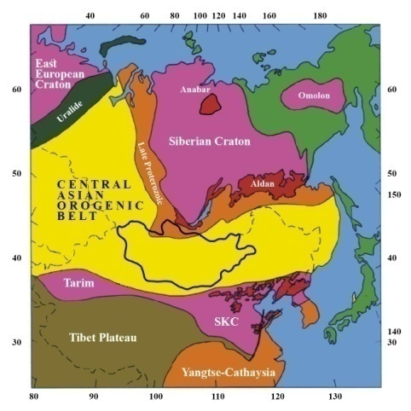
LITHIUM MINERALIZATION IN MONGOLIA
Lithium Deposits
D1 – Munkhut (MTD)
D2 – Arbayan (ABD)
D3 – Khukhdel (KDD)
Mineralized points
M1 – Khast khud (KKM) M2 – Ongon khai. (OKM) M3 – Noname 2 (N2M)
M4 – Noname 1 (N1M)
M5 – Tsagaan uul (TUM)
M6 – Arasan (ASM)
M7 – Ber. Uul (BUM)
M8 – Shar tolgoi (STM)
M9 – Khiliin (KHM)
Occurrences
O1 – Khukhdel (KDO) O6 – Baga Ikh (BIO)
O2 – Bayanteeg (BTO) O7 – Khetein (KHO)
O3 – New Occ. (NOW) O8 – Occur233 (O233)
O4 – Yagaan del (YDO) O9 – Bor khuj (BKO)
O5 – Noname1 (NNO) O10 – Urt gozgor (UGO)
Schematic map of the CAOB
(Jahn et al., 2004)
World Mining Congress, Ulaanbaatar, Mongolia, 2022.07.12

Slide 29
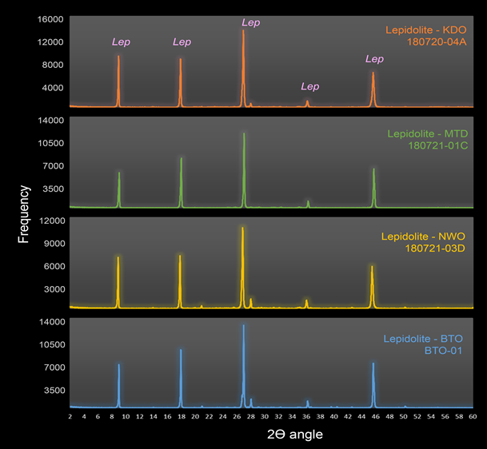
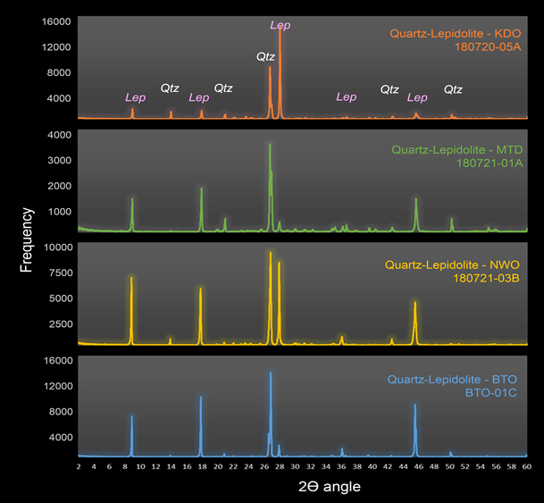
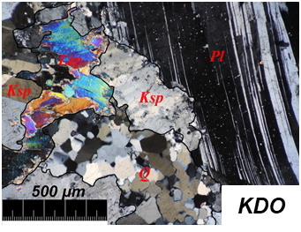
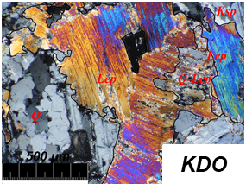










Ore mineral characteristics f lithium ore (Lepidolite, spodumene, elbait)
World Mining Congress, Ulaanbaatar, Mongolia, 2022.07.12

Slide 30









Formation temperature of Li-minerals (FI-Microthermobarometer)
Sample No | Name | Number of Measurement |  | Freezing T˚C | Ice melting T˚C |  | Homogenies T˚C
 |  |  |  |  | Start | End
FI-01 | KDO | 8 | Max | -59.0 | -38.7 | -0.4 | 281.0
 |  |  | Min | -68.0 | -44.0 | -9.0 | 146.0
FI-02 | MTD | 7 | Max | -67.6 | -38.5 | -0.5 | 267.6
 |  |  | Min | -67.6 | -41.2 | -6.5 | 249.4
FI-03 | NWO | 9 | Max | -58.7 | -36.2 | 0.0 | 216.0
 |  |  | Min | -69.5 | -49.5 | -3.5 | 149.7
FI-04 | BTO | 8 | Max | -69.9 | -48.9 | -0.6 | 236.0
 |  |  | Min | -72.8 | -54.8 | -6.8 | 149.7
World Mining Congress, Ulaanbaatar, Mongolia, 2022.07.12

Slide 31

Distribution of nickel and cobalt mineralization in Mongolia
3 deposits (Bor khag, Nogoon tolgoi, South)
World Mining Congress, Ulaanbaatar, Mongolia, 2022.07.12

Slide 32



Bor khag Ni-Co deposit
Ultramafic related listwaenite hosted Ni-Co mineralization (Cr, Cu, Pt). Ore body: 2-10m thick, 15-60m long 11 lense shaped bodies. Ore minerals: Co-pyrrothite, chromite, pentlandite. Ore grade: Ni 0.02-0.2%, Cr 0.01-0.02%, Cu 0.01-0.07%, Ag-0.7ppm, Co 0.02% агуулгатай.
World Mining Congress, Ulaanbaatar, Mongolia, 2022.07.12

Slide 33



Mergen bulag cluster occurrences
Mergenbulag cluster occurrences are located along the longitudinal striking Kharig gol thrust zone, which continues approximately 20 км, and found 4-5 occurrences and several anomalous areas.
Ore body: 100 m length, 11 m wide carbonate and silica dominated listwaenite
Ore mineral: Pyrite, limonite, chalcopyrite.
Ore grade: Co 0.01-0.02%, Ba 0.5-2.49%, As 0.01%
World Mining Congress, Ulaanbaatar, Mongolia, 2022.07.12

Slide 34



Tsagaan gol nickel occurrence
Тектоник хагарлын дагуу хүчтэй хувирсан, серпентинжсэн, том ширхэглэг габбро нь үеллэг тогтоцтой, хар бараан өнгөтэй хэсэгтээ магнетит ихтэй, зарим хэсэгтээ пироксен ихтэй, фуксит, гидротермаль карбонатын судлуудтай. Элэгдэл, өргөгдөл хүчтэй явагдсан буюу хүдрийн биет ил гарсан. Хүдэржилтийн төрөл хүдрийн болон хувиралын эрдсийг тодорхойлох гол ашигт бүрдвэрийн агуулгыг тодруулах зорилгоор хүдэржилтийн төрөл бүрээс болон агуулагч чулуулгаас дээжилсэн.
World Mining Congress, Ulaanbaatar, Mongolia, 2022.07.12

Slide 35


Regional tendency
Tuwa-Mongolia
Khowu Aksy Co-deposit
World Mining Congress, Ulaanbaatar, Mongolia, 2022.07.12

Slide 36

Manganese mineralization
6 deposits
98 occurrences
Schematic map of the CAOB
(Jahn et al., 2004)
World Mining Congress, Ulaanbaatar, Mongolia, 2022.07.12

Slide 37

Distribution of graphite
6 deposits
93 occurrences
Schematic map of the CAOB
(Jahn et al., 2004)
World Mining Congress, Ulaanbaatar, Mongolia, 2022.07.12

Slide 38
THANK YOU
for
ATTENTION
World Mining Congress, Ulaanbaatar, Mongolia, 2022.07.12

